Slide 1
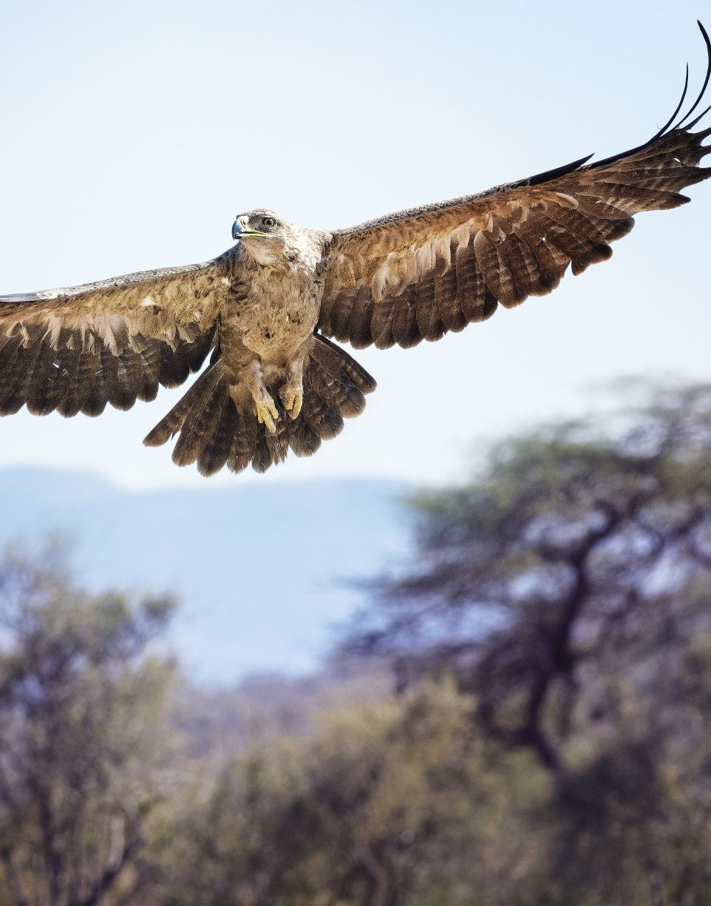
Welcome to Buzzards!

Slide 2
Owls Class Staff
Mrs Shallish – Class Teacher
(Monday to Friday)
Miss Birmingham - Higher Level Teaching Assistant
(Monday - Friday)
Miss Catherine – Forest School Leader
(Thursday afternoons)

Slide 3
The Year 1 Curriculum
Year 1 is the start of the National Curriculum
We teach Core and Foundation subjects across the week, with some alternating over the half terms
Any gaps from the EYFS areas of learning will be covered through our ‘Play to Learn’ time
Learning tasks are completed in a range of ways; independently in the provision, through guided groups, or with a partner
Whole class carpet inputs
Any children who need additional support to keep up with the curriculum may have group or individual interventions throughout the school week
Please see the curriculum letter for more details about what the children will be covering in each subject.

Slide 4
The Year 1 Curriculum
Daily English - Science
Daily Maths - Geography/History
Daily Phonics - Art & DT
Daily Guided Reading - RE
- Music
        - Computing
        - PSHE
        - PE & Outdoor Games

Slide 5
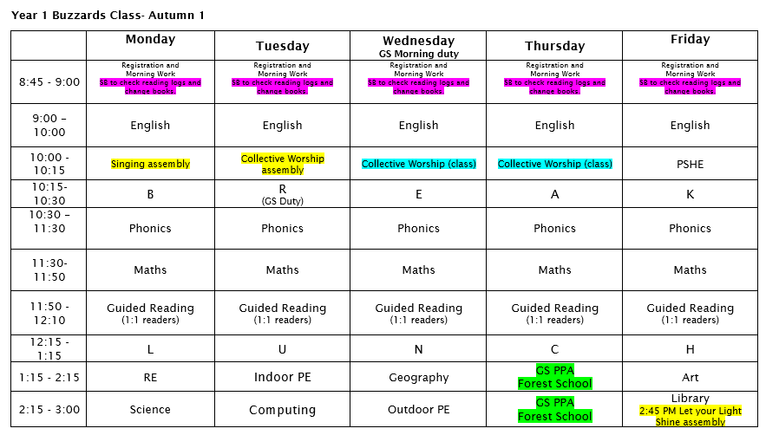
Timetable

Slide 6
Rewards and Sanctions
Rewards:
Sanctions:
House Points
    Attenborough
    Rashford
    Rowling
    Nightingale
Rainbow
Special Mention
Stickers
Class mascot
‘Let Your Light Shine’ certificates
Verbal Warning
Behaviour Chart
Minutes off playtime
Sent to SLT
Note/call home

Slide 7
Uniform
At Frieth, we believe that the school uniform contributes to our school ethos and instils a sense of belonging to the school. We ask the children to take pride in their appearance and to look smart in school.
School sweatshirt / plain royal blue cardigan / jumper
White or pale blue polo shirt
Black or grey skirt or trousers
White, grey or black socks / black tights
Fleece for outdoor wear (optional)
Black low-heeled shoes / sandals without open toes. Sling backs are not allowed.
In the summer, some pupils choose to wear a royal blue and white checked dress or shorts
Please ensure that all clothing that your child wears or brings into school is clearly named.

Slide 8
Equipment in school
EVERY DAY
  Bookbag
  Reading Pouch (reading book and reading record)
  Any relevant letters/notes/permission slips in Reading Wallet
  Water bottle
  Jumper/Cardigan (named)
  Waterproof coat (named)
  PE kits (staying at school for the half term)
Thursday – Forest School kit (long sleeves/legs, coat/waterproofs)
SAFEGUARDING
Please write a note in Reading Record if there is a change in pick up arrangements.

Slide 9
P.E.
The class will have two P.E. lessons per week.
This term, P.E. will take place on Tuesdays and Wednesdays.
P.E. Kit
T-shirt with school logo or plain white T-shirt
Royal blue or black shorts
Trainers
Royal blue or navy sweatshirt and jogging bottoms

Slide 10
Homework for Year 1
Homework tasks will be set weekly (Friday to Friday)
on Microsoft Teams (logins to be sent)/printed sheets in book bags:
  Weekly printed spellings sheet
  Alternating weeks of Maths (Mathletics)/English (comprehension-based task)
Reading book(s) and Reading Records will be checked every day in school and changed if they have been read
The expectation is that all children should read at home every day

Slide 11
Homework expectations
Please ensure your child is reading daily at home and the reading record is filled in every day: date, title, pages read and any comments
It is expected that homework is always completed and handed in on time (except in special circumstances)
If children are having some difficulties with homework, we will be more than happy to go over it again with them
If there is a reason homework couldn’t be completed please email the teacher and make them aware
Mathletics logins will be sent home in reading pouches this week

Slide 12

Reading at home
Daily reading at home is essential at this age
It is good practice to read the same book again for fluency
Ask lots of questions about the book – it helps with the comprehension (Blank’s questions)
Children read to the teacher/LSA/Reading Volunteers every day in school
Word recognition and decoding
Comprehension
Benchmarking
Children will be Benchmarked when they are ready to move up to the next level, both in terms of word recognition and comprehension.

Slide 13
Phonics Screening Check 2026
The Phonics Check will take place the week beginning Monday 8th June
The Screening will check the child’s knowledge of the 44 sounds taught across Reception and Year 1
Children will read 40 words (20 real, 20 pseudo) in a 1:1 setting with Mrs Shallish
The pass mark is usually 32/40, and if a child does not pass, they will get another chance to retake the check in Year 2
More information on the check will be provided nearer the time

Slide 14
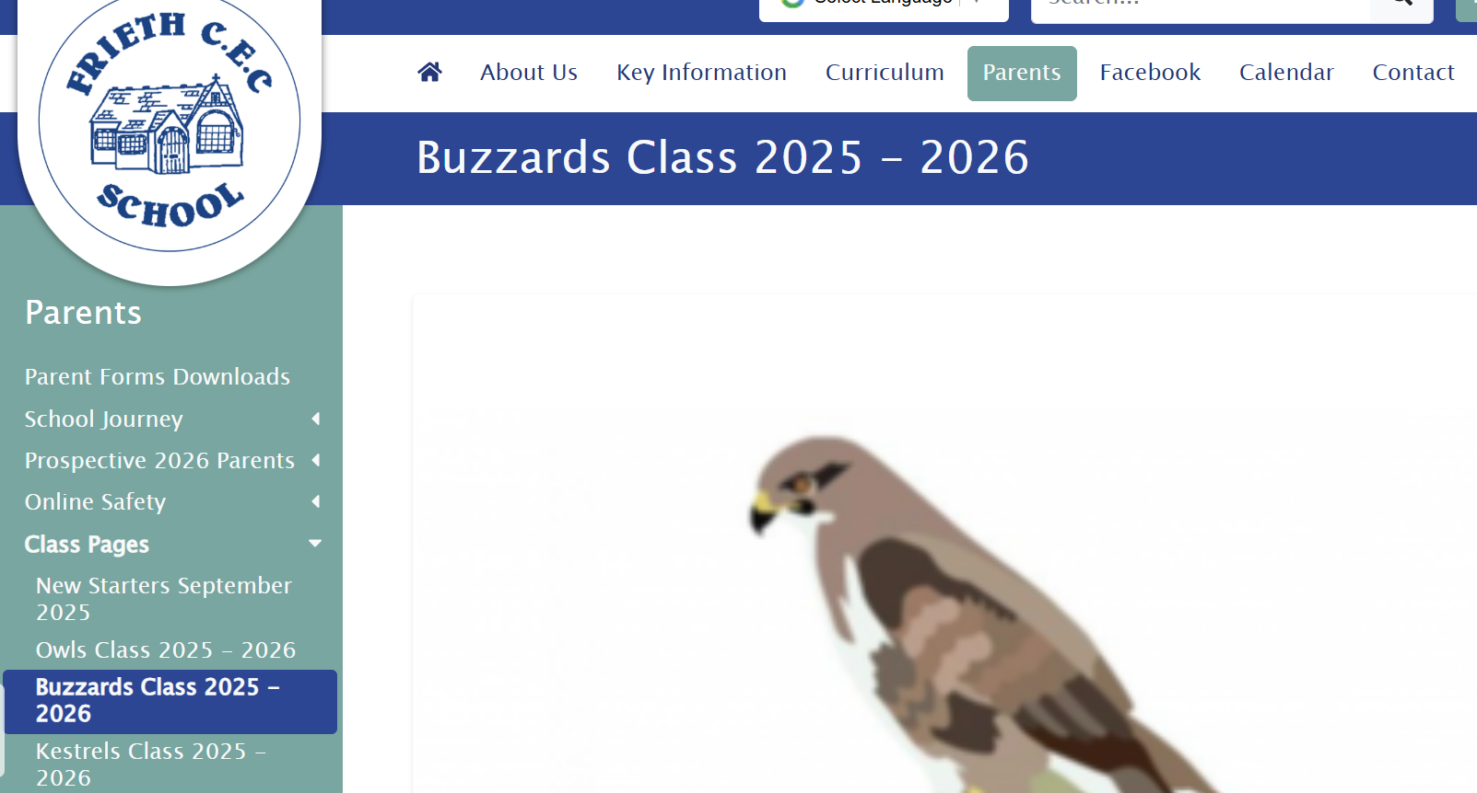
The school website – up and running Friday
https://www.friethschool.co.uk

Slide 15

Forest School
Each Thursday afternoon, the class will take part in outdoor Forest School activities with Miss Catherine.
The children need to come to school on Thursday mornings wearing long-sleeved tops, full-length trousers and regular school shoes
The rest of their Forest School kit must be sent to school in a separate bag. Parents are asked to provide suitable clothing e.g. waterproof jackets, trousers and wellington boots
At the end of the day the children will be going home wearing their Forest School kits

Slide 16
Food and Drink
All Key Stage 1 children are entitled to a free school meal each day
Packed lunches should support our school’s healthy eating policy
Please note that our school is a ‘nut free’ zone which means that all types of nuts are banned
FIZZY DRINKS are not allowed in school lunches or water bottles
Children will receive a free fruit or vegetable snack during the morning
Paid for milk scheme – please liaise with the school office if you wish to order milk for your child

Slide 17

Health
Staff need to be aware of your child’s medical background. In particular, any allergies, any dietary restrictions and any medical conditions that are important for us to know (e.g. asthma or eczema). Please let the school office know
Children can suddenly become ill and therefore it is important that we know we can contact you or another adult relative/friend at all times. Please ensure that the school is kept up to date with your contact details
If your child is unable to attend school due to illness, please telephone the school office to let us know
48-hour rule for sickness and diarrhea

Slide 18
Links to the Church
At Frieth, we have Collective worship most days. This takes place during assemblies in the school hall. We are also very fortunate to welcome in members of the clergy each week.
Our Vision is
‘Let your Light Shine!’
Our vision encourages our children to show the world how wonderful they are, in both the good character and values they display and in their unique qualities and talents.

Slide 19
Communication
It is very important that the children feel they can talk to their teachers if they have a worry
If parents or carers have any concerns, please send a short email (gshallish@friethschool.co.uk)
First aid in school – SmartLog notification to parents (bumped head sticker)

Slide 20

Help!
We are always looking for parent volunteers to help with:
Reading Volunteers
Cooking with the class
Trips
Jobs around the Year 1 area
If you are available to help, please let the class teacher know.

Slide 21

Any Questions?

