Slide 1




Keeping our teeth healthy
Play this slideshow from beginning

Slide 2


    We are learning about keeping teeth healthy
  We will be able to:
identify food and drink with different sugar content
describe how to clean teeth properly
recognise who can help with keeping teeth healthy

Slide 3

What’s our starting point?
Draw and write
Draw a person’s face with healthy teeth
Then:
Draw or write who can help to keep their teeth healthy
Draw or write what could harm their teeth

Slide 4


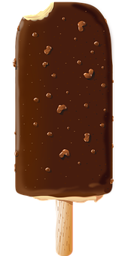
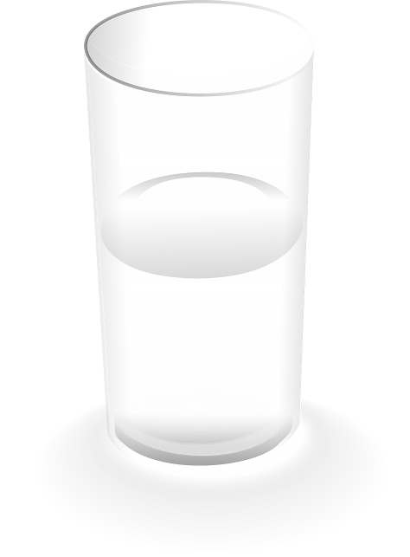
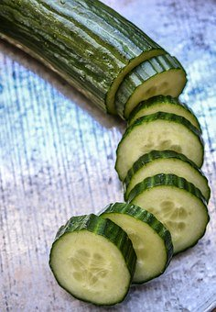
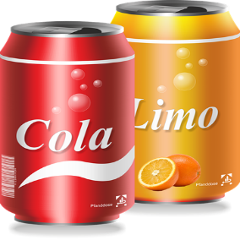

This is Jamal, he has nearly ALL of his adult teeth!
Jamal needs help with keeping his teeth healthy. First, he needs to work out which food and drink to choose….

Slide 5
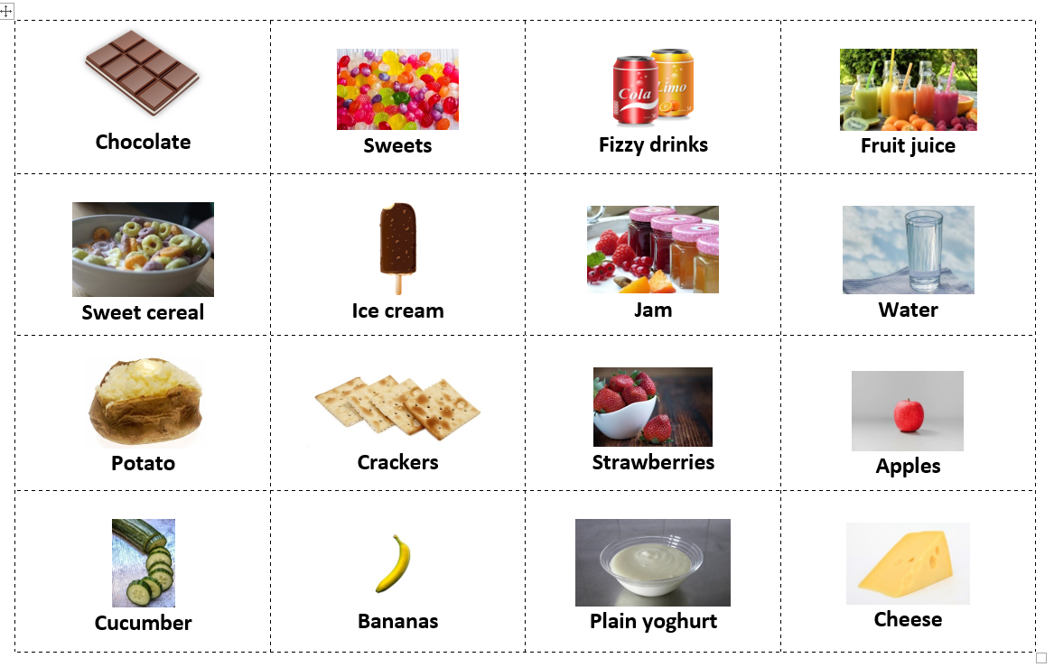

Food and drink
Jamal needs to know which food and drink is higher in sugar and which is lower….
Use the food and drink cards from your worksheet pack (Resource 1: Food and drink cards) and help Jamal decide by writing Higher or Lower on each card

Slide 6
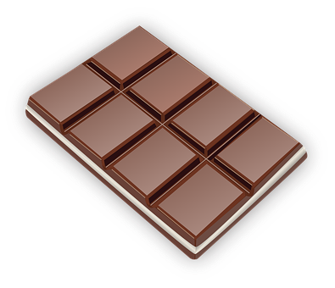
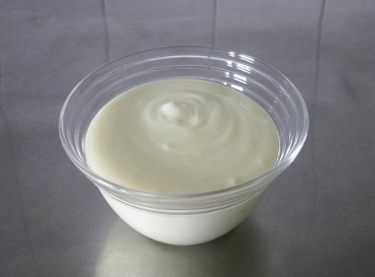
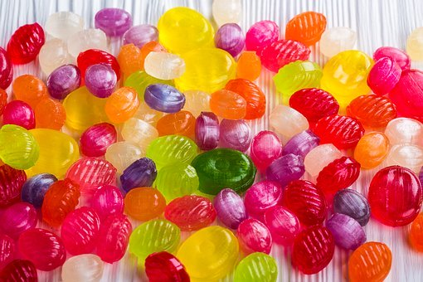

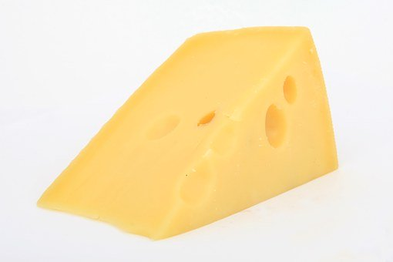
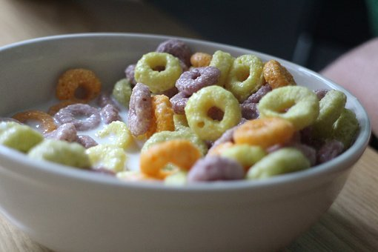
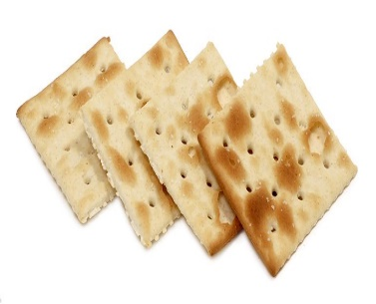

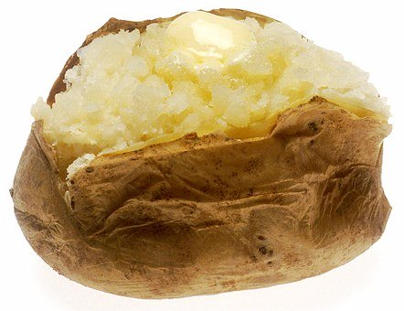

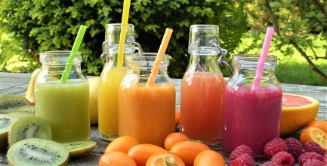
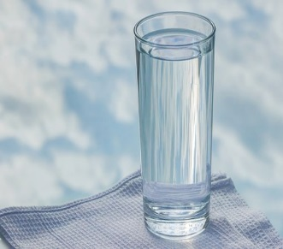
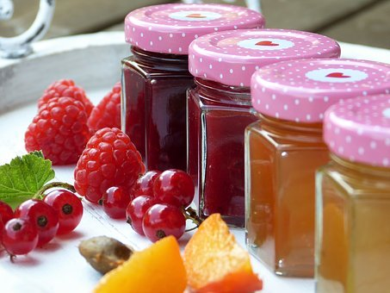
Higher in sugar
Lower in sugar
Click on this card to reveal the answer
Click on this card to reveal the answer

Slide 7
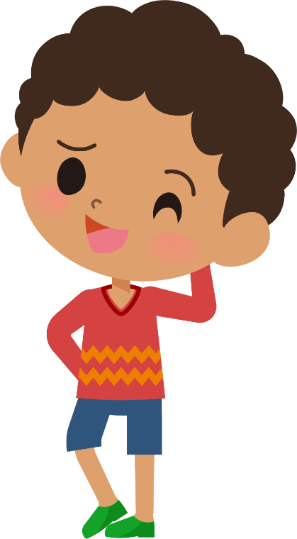
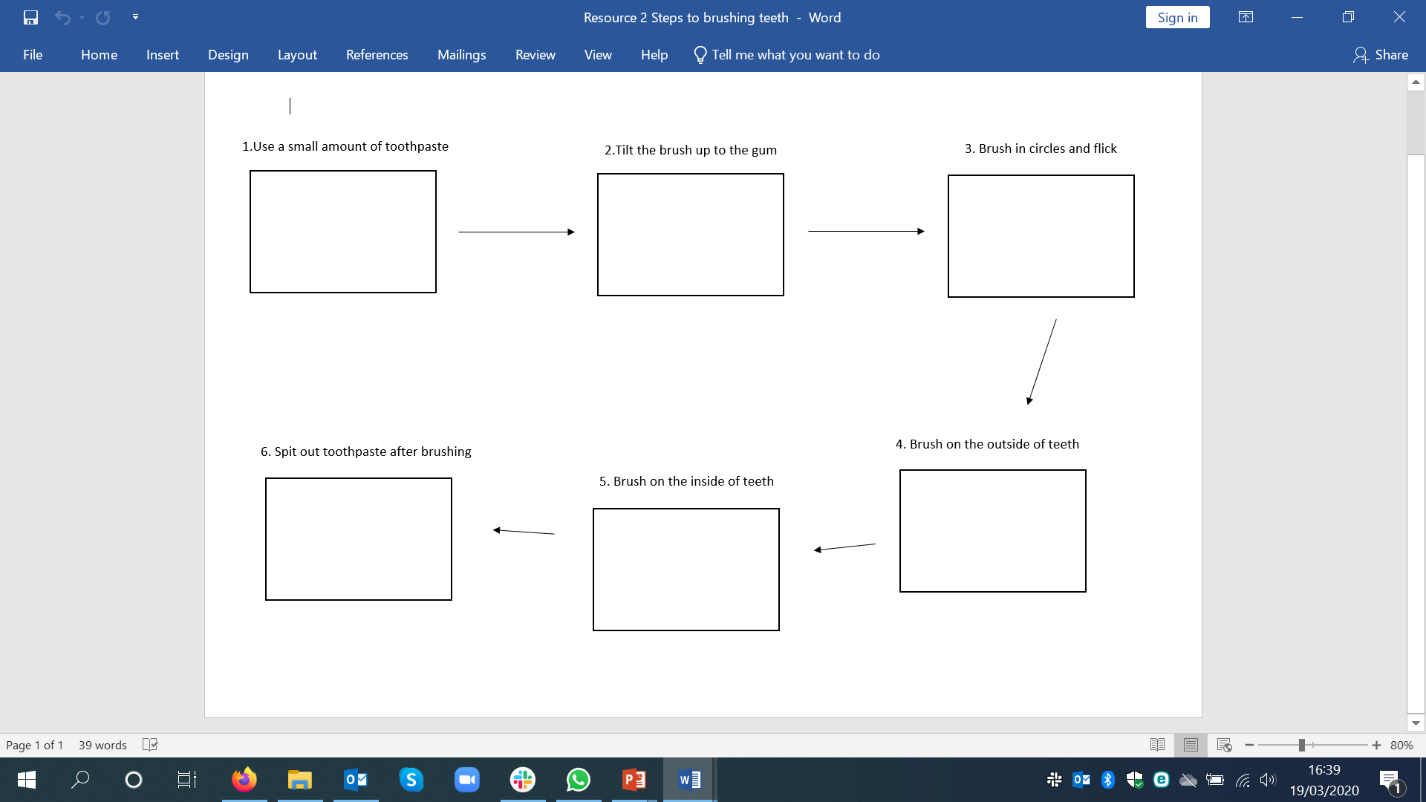

Can you help Jamal with brushing his teeth? Use the teeth brushing steps in your worksheet pack (Resource 2: Steps to brushing teeth) and draw a picture in each box
Teeth brushing

Slide 8
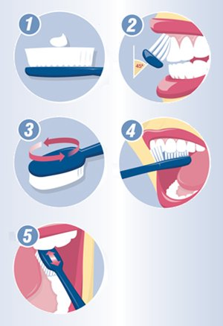
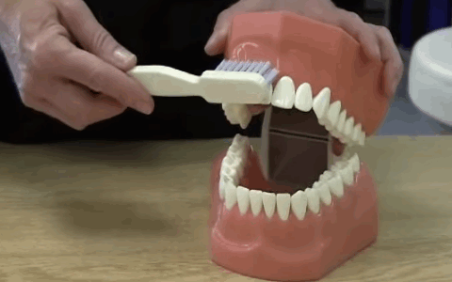
Teeth brushing
Spit out the toothpaste after brushing
Let’s go over the steps!
Remember to brush for 2 minutes!

Slide 9
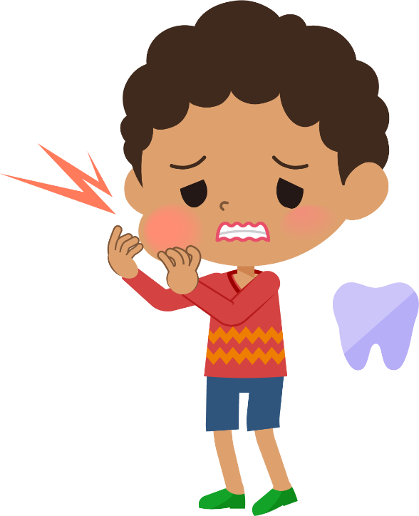

Ouch!
Jamal is getting much better at brushing his teeth properly and his Dad has helped him. But sometimes, Jamal has been busy playing with his toys before bed and has forgotten to brush his teeth. One morning he wakes up and “Ouch!”, Jamal’s mouth is hurting a lot and is swollen.
What is making Jamal’s mouth hurt?
What should Jamal do next?
Jamal has forgotten to brush his teeth! What other reasons could there be for someone not brushing their teeth?
What could help Jamal to remember to brush his teeth twice every day?

Slide 10
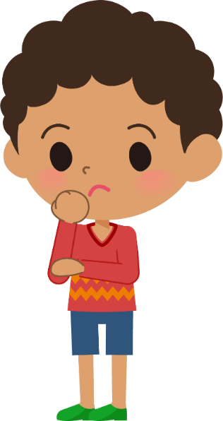
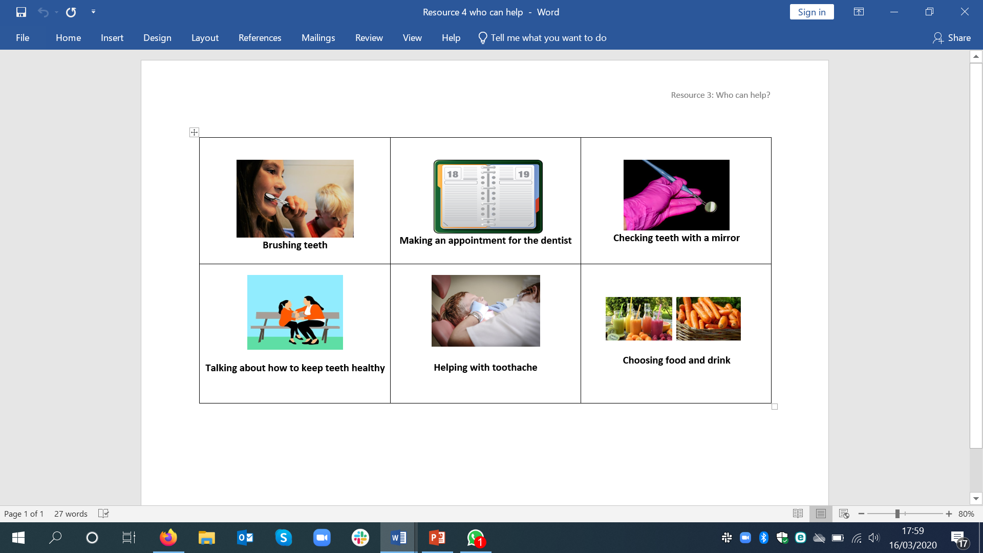
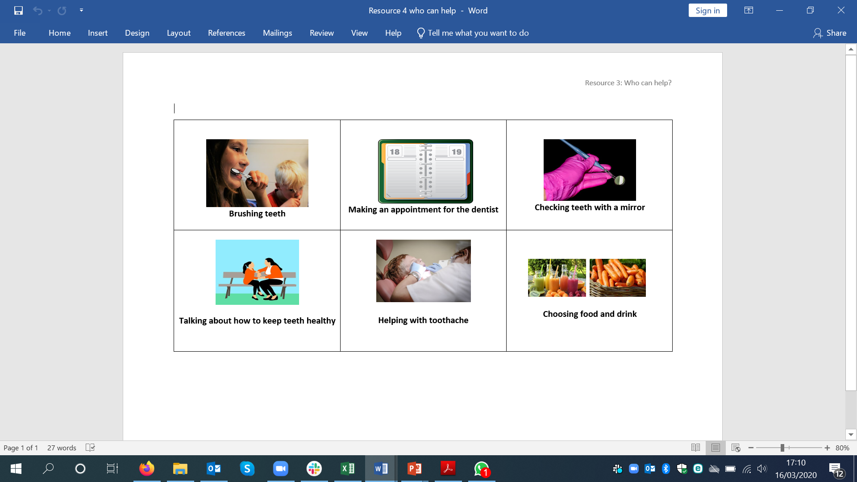
Who can help?
Decide who can help with our keeping teeth healthy by putting the card in the right circle. If it is both, put it in the middle!
Parent or carer
Dentist

Slide 11

Keeping our teeth healthy
Well done on completing the activities!
Now go back to the ‘What’s your starting point?’ activity
Draw and write
Is there anything you would like to change?
Is there anything you would like to add?

