Slide 1
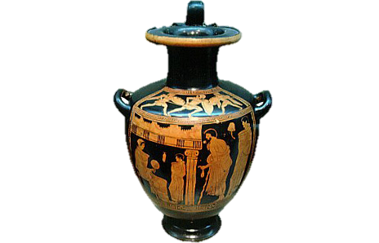
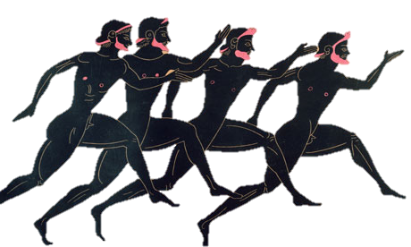
Ancient Greek Pottery

Slide 2
LOB To understand what the Ancient Greeks used their different vases for. To create our own vase design in the style of the Ancient Greeks.

Slide 3
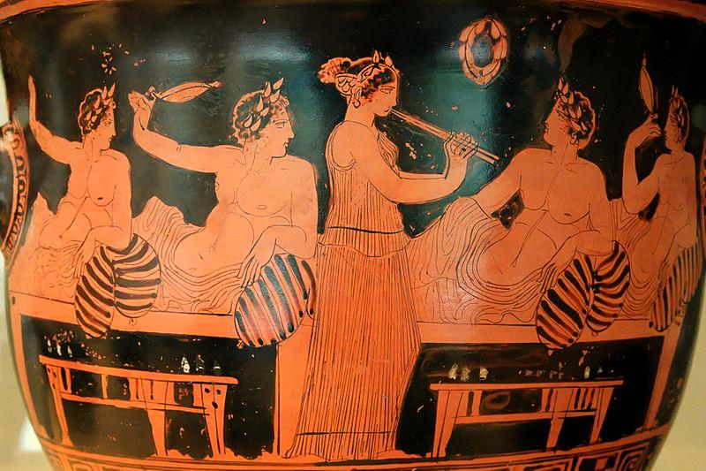
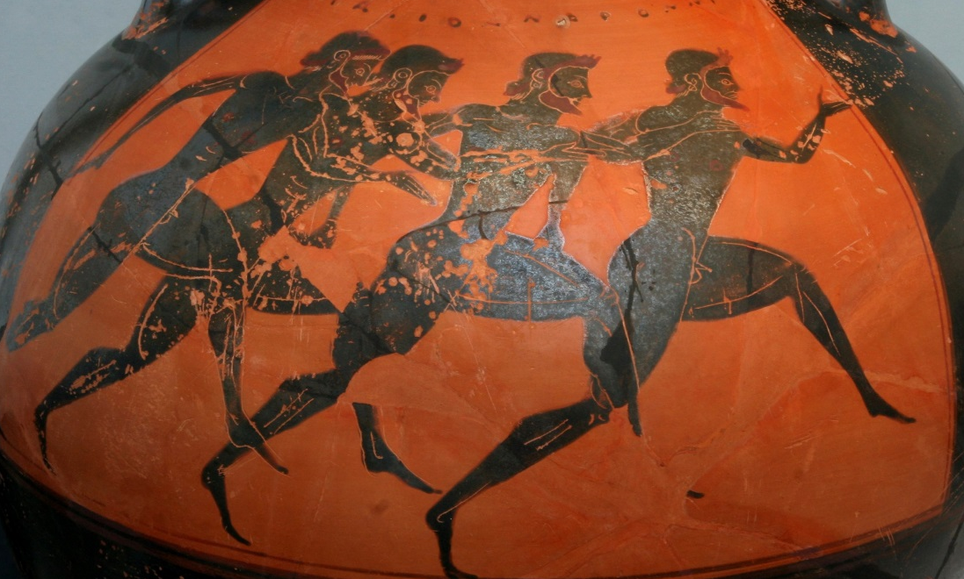
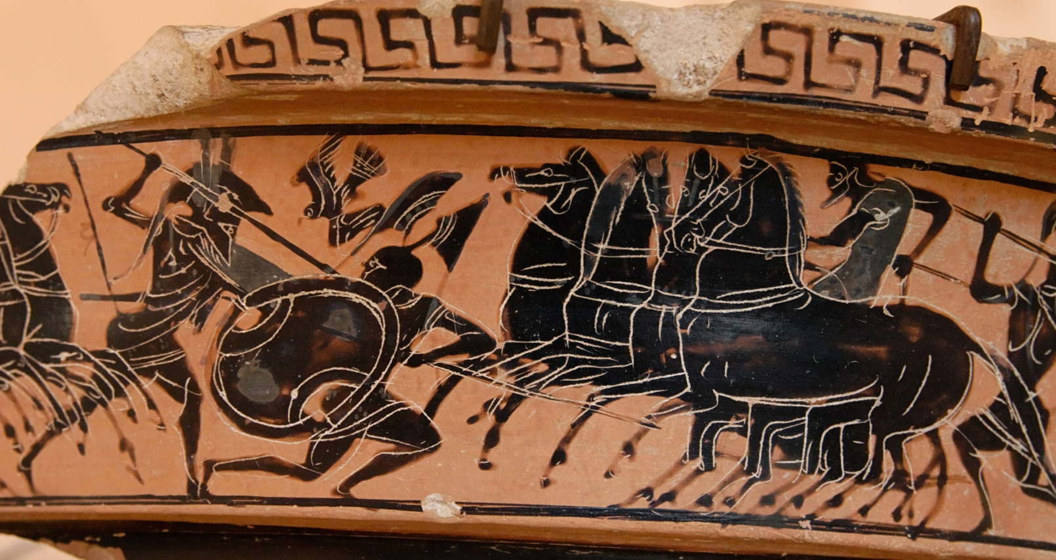

Slide 4
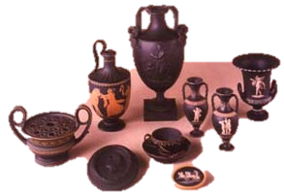
Pots were used for lots of different things. There were different shapes for different functions.

Slide 5
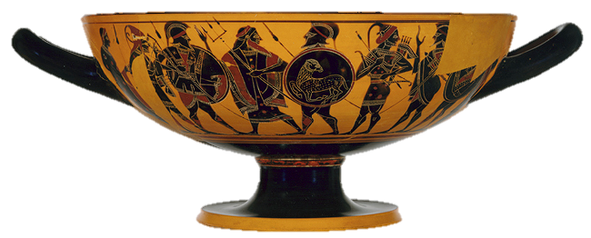
Only men were allowed to make pots in Ancient Greece, although women were allowed to decorate them.

Slide 6
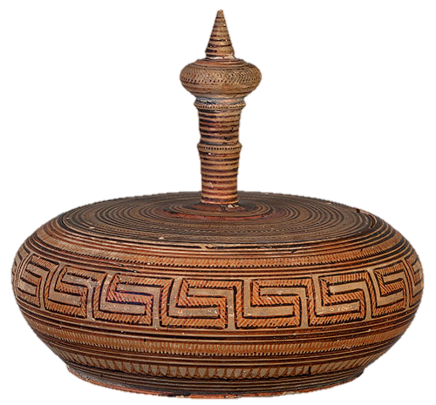
The first pottery was decorated with lots of geometric patterns.

Slide 7
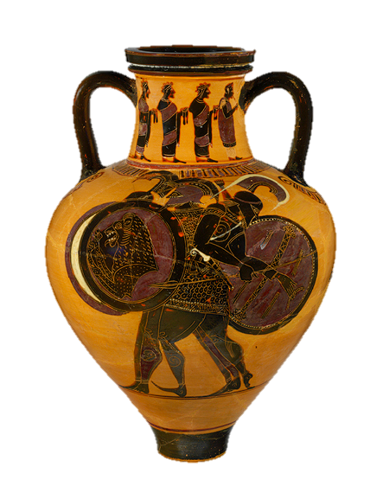
Then came black figure pottery. The design was made using slip that turned black when fired in the kiln. White or purple detail was added afterwards.

Slide 8
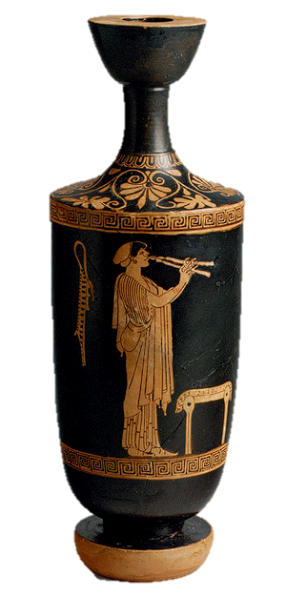
The red figure technique was invented around 530bc. This time, the rest of the pot was painted with slip rather than the figures and patterns. Detail was added later.

Slide 9
Your Task
Go to the British Museum website and choose your pot shape.
Write down your chosen vase and what it was used for in Ancient Greece.
Decide the modern day picture and repeated patterns you would like to draw and practice your design.
Write about why you have chosen that picture. What would it tell people about life today?
Draw your vase shape using a template and draw your picture ready for the display.

