Slide 1
The Olympic Oath and Creed

Slide 2
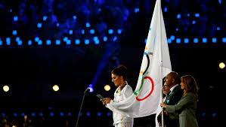
History of the Olympic Oath
The Olympic Oath is taken on behalf of all competitors, judges and trainers at the opening ceremony of the Olympic games. The nominated person from the hosting country holds the corner of the Olympic flag and reads aloud the oath whilst all other competitors form a semicircle around the rostrum.

Slide 3
How has it changed?
For many years the Oath was:
“In the name of all competitors, I promise that we will take part in these Olympic Games, respecting and abiding the rules which govern them, in the true spirit of sportsmanship, for the glory of sport and the honour of our teams”
What do you think they are trying to say with this oath?

Slide 4
Changes to the Olympic Oath
At the Sydney 2000 Summer Games the oath included the first reference to not taking drugs.
“In the name of all competitors, I promise that we will take part in these Olympic Games, respecting and abiding the rules which govern them, committing ourselves to a sport without doping and without drugs, in the true spirit of sportsmanship, for the glory of sport and the honour of our teams”
Why do you think it was important to add this reference to the oath?

Slide 5
Is the Olympic Oath been taken at all games?
The first oath was taken in 1920 at the summer games in Antwerp but they are a legacy of the Ancient Greek Olympics where an oath was taken in front of the statue of Zeus. A sacrifice was offered and the athletes swore that they had trained properly (for 10 months) and that they would obey the rules of the games.
Judges have taken the oath since 1972 winter Olympics in Sapporo but again refers back to Ancient Games where judges swore to judge fairly and without bias. It says:
“In the name of judges and officials, I promise that we shall officiate in these Olympic Games with complete impartiality, respecting and abiding by the rules which govern them in the true spirit of sportsmanship”

Slide 6
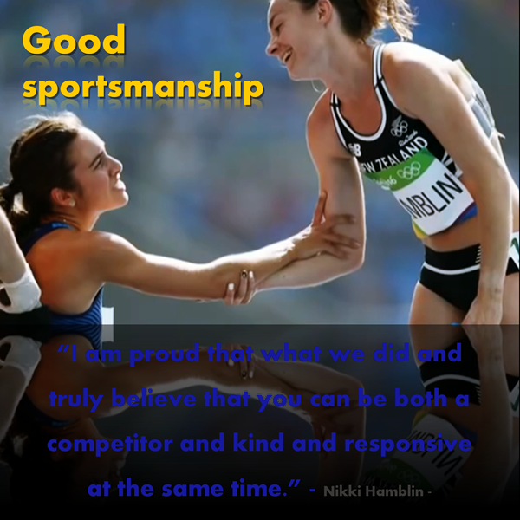
Sportsmanship
Sportsmanship is another way to say ‘being a good sport’. But what does that mean? You can’t guarantee that you will win when you play sport. But, how you participate is under your control. Sportsmanship and the notion of taking part ere two ideals promoted by Baron de Coubertin in his quest to revive the Olympic Games.
respect
equality
determination
friendship
What does sportsmanship mean to you?
Can you add any words to explain?
inspiration
excellence
courage

Slide 7
Sportsmanship Questionnaire
Identify the behaviours which demonstrate examples of ‘sportsmanship’. Highlight those ideals to which Baron de Coubertin hoped Olympic athletes would aspire to. Can you add further examples of Olympic ideals for today in the blank boxes?
Remember that winning isn’t everything
Shout at the coach or referee if you don’t win
Congratulate the winner
Yell at team-mates who make mistakes
Practise so you are prepared for competition
Blame others in your team when you don’t win
Give up if you feel you will be defeated
Treat all players with respect
Take all the credit for winning

Slide 8
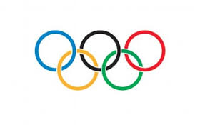
Dear Students,
The International Olympic Committee, the organising body reponsible for the Olympic Games, is currently reviewing the ‘Olympic Oath’ taken by competitors during the Opening Ceremony of each Olympic Games.
The Olympics are held every four years and are a celebration of human spirit. We need to ensure that the oath taken by athletes truly reflects the values we hold so high.
The new ‘Oath’ should include the ideals held by our founder, Baron de Coubertin and also promote the spirit of sportsmanship and fair play.
We would be delighted if you would give the matter some considerable thought and write a new ‘Olympic Oath’ to be taken by the competitors from all nations who will gather to participate in the next Olympic Games.
Yours sincerely,
Members of the International Olympic Committee.

Slide 9
Values to be included in a new Olympic Oath
My Olympic Oath for today (draft)
In the name of all competitors, I promise…

Slide 10
My Olympic Oath for Future Generations
In the name of all competitors, I promise…

