Slide 1
Transition:
Moving to a new class
To start, play this slideshow from beginning
© PSHE Association 2020

Slide 2
We are learning how to manage our feelings about moving to a new class
We will be able to:
identify feelings people might experience when moving to a new class.
recognise common causes of worry, challenges and opportunities that may be part of this transition.
explain ways to positively manage the move to a new class.
© PSHE Association 2020

Slide 3
Identifying feelings
River is moving from Year 2 to Year 3 this year and has lots of feelings about the change.
Can you think of any of the feelings that River might have?
In the circles in Resource 1, write down or draw any good feelings River might have, any bad feelings that River might have and any feelings that are a bit of both!
Feelings that are a bit of both
Good feelings
Bad feelings
© PSHE Association 2020

Slide 4
Similarity and difference
Most of the time River feels excited, but also a bit nervous. Think of some reasons why, by writing down or drawing answers to the two questions below.
In what ways will school be the same in Year 3?
In what ways will school be different in Year 3?
© PSHE Association 2020

Slide 5
Similarity and difference
Similarities might include:
Friends and classmates
The school environment (buildings, playground, field etc.)
Subjects (e.g. Maths, English, Science)
The help and support available
Differences might include:
A new teacher (or two teachers)
A new classroom and place to sit
A different break time
New clubs to join
Changes in friends
Working independently a bit more
© PSHE Association 2020

Slide 6
Changes
River has been thinking about the changes that will happen in Year 3.
While there are good things about each change, River has questions about some of the changes.
Using the table in Resource 2, or on a piece of paper, note down any positive things about each change and any questions River might have about each change.
What other changes might River be thinking about or be worried about?
© PSHE Association 2020

Slide 7
Managing changes
What could River do to manage the ‘not so good’ things?
Think about good changes
Keep trying
Spend time relaxing
Focus on the positives
Be organised
Ask for help
What could River do to manage the ‘not so good’ things?
E.g. Think about good changes
How could River make the ‘not so good things’ feel a bit better?
E.g. Could River think about all the good changes they have managed since the start of Year 2, to help feel more positive about changes in Year 3?
Add your ideas to the bubble map in Resource 3, or draw your own bubble map!
Need help? Click the green circles to reveal some examples…
© PSHE Association 2020
Notes:
What could River do to manage the ‘not so good’ things?
Examples
Keep trying
Spend time relaxing
Focus on the positives
Be organized
Ask for help

Slide 8
Giving advice
Thinking about all the different ways of managing changes, and any new ideas you have, write a short sentence of advice to two individuals in Resource 4.
For each pupil you choose to advise, explain what they could do to help manage their problem.
Then, click each name on the next slide to reveal a possible answer.
© PSHE Association 2020

Slide 9
Giving advice
Click on the names below to find the answers!
Jemma
Harry
VJ
Mateo
VJ could:
Take some time to relax before the test, e.g. by taking deep breaths.
Practice her spellings in a different way, e.g. by writing each spelling in a sentence or asking someone to test her.
Spend her time focusing on the words she doesn’t know, rather than on the words she already knows well.
Jemma could:
Ask a friend or someone else on her table to help.
Leave this question out and try the next one.
Come back to the question at the end and give it another go.
Harry could:
Put his pencil case on his desk straight away every morning.
Decide on a ‘home’ for his pencil case so that he always puts it back in the same place after he’s used it.
Mateo could:
- Speak to a teacher or adult about his worries, rather than listening to rumours that might not be true.
© PSHE Association 2020
Notes:
Jemma
Jemma could:
Ask a friend or someone else on her table to help.
Leave this question out and try the next one.
Come back to the question at the end and give it another go.
Harry
Harry could:
Put his pencil case on his desk straight away every morning.
Decide on a ‘home’ for his pencil case so that he always puts it back in the same place after he’s used it.
VJ
VJ could:
Take some time to relax before the test, e.g. by taking deep breaths.
Practice her spellings in a different way, e.g. by writing each spelling in a sentence or asking someone to test her.
Spend her time focusing on the words she doesn’t know, rather than on the words she already knows well.
Mateo
Mateo could:
- Speak to a teacher or adult about his worries, rather than listening to rumours that might not be true.

Slide 10
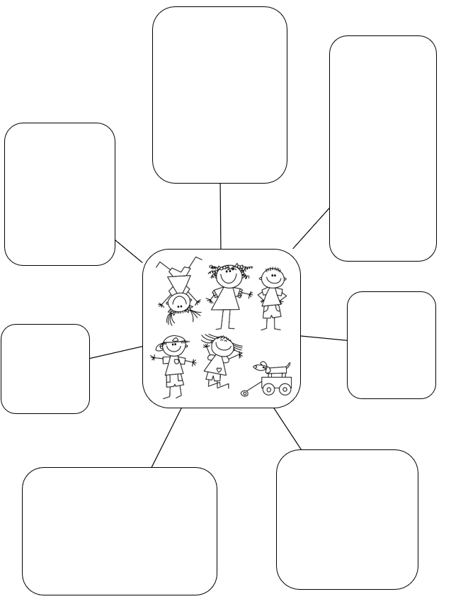
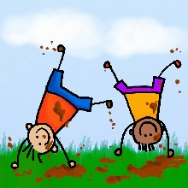
Looking ahead
E.g. join a new club
Create a poster of pictures and words showing all of the things River could look forward to in Year 3, as well as all the things or people that can help them.
Use the template in Resource 5 to help you, or design your own!
Once completed, put it up somewhere in your house to remind you of all the exciting things ahead.
© PSHE Association 2020

Slide 11
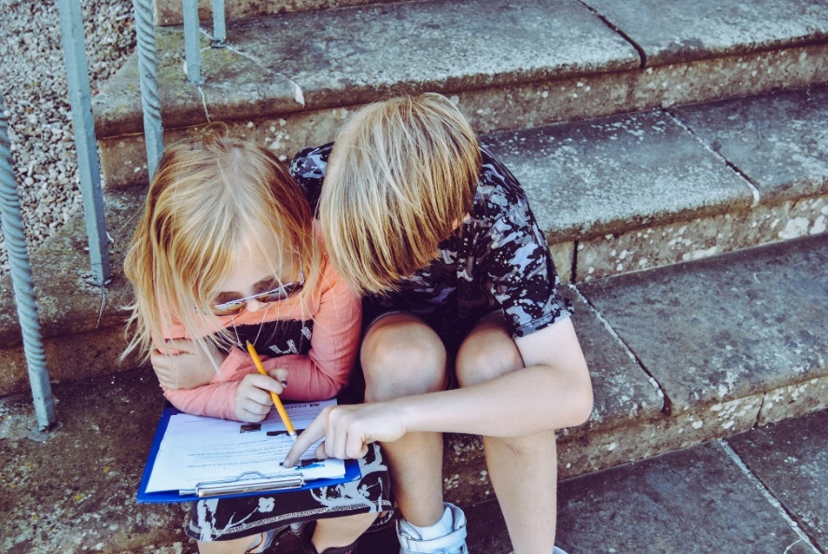
Asking for help
Who could River tell, either in school or at home, if something was making them feel unhappy because of the move to Year 3?
Remember, you can always speak to a parent/carer or trusted adult if you are worried or unhappy about the move to key stage 2.
© PSHE Association 2020

