Slide 1
PSHE and Citizenship
Health and Wellbeing | Looking After Your Wellbeing
PSHE and Citizenship | Age 7-9 | Home Learning | Health and Wellbeing | Looking After Your Wellbeing

Slide 3
Aim
I understand that there are strategies and behaviours that support my mental health and wellbeing.
Success Criteria
I can think of ways I can be kind to myself.
I can list the things I can control and the things I can’t control.
I can think of ways to connect with other people for support.
This resource is fully in line with the Learning Outcomes and Core Themes outlined in the PSHE Association’s Programme of Study.

Slide 4
The Big Questions

Slide 5
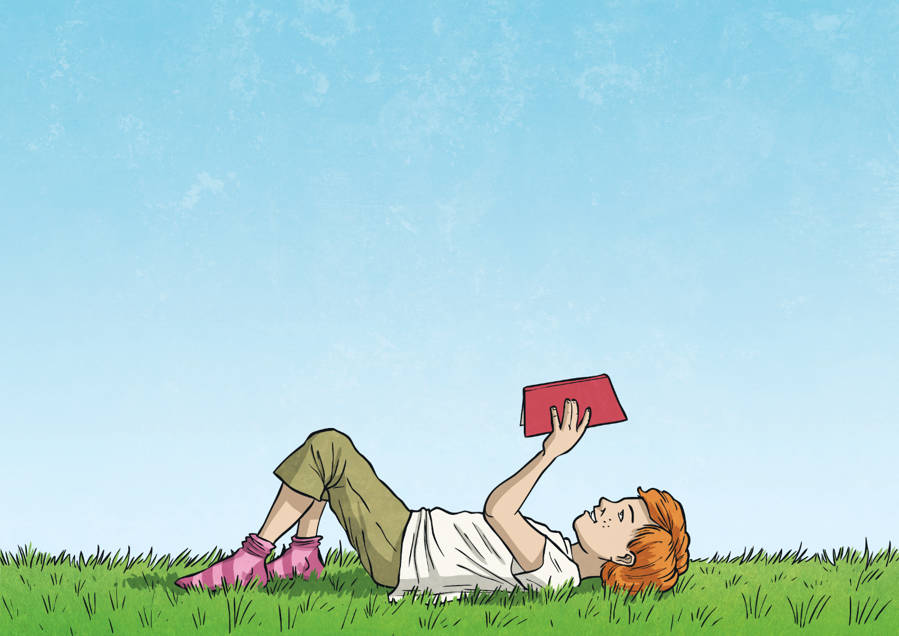
What is wellbeing?
How can I look after my own wellbeing?

Slide 6
What Is Wellbeing?
When you try to look after your own wellbeing, you think about:
how comfortable you are (both physically and mentally);
how healthy you are (both physically and mentally); and
how happy you are.
Wellbeing is explained as feeling…
comfortable,
healthy,
or happy.
If life changes, you may feel a lack of control, which can then make you feel unsettled. This can affect your wellbeing and how you feel. Changes can take you out of your comfort zone and make you see life a bit differently; all of which can be unsettling.

Slide 7
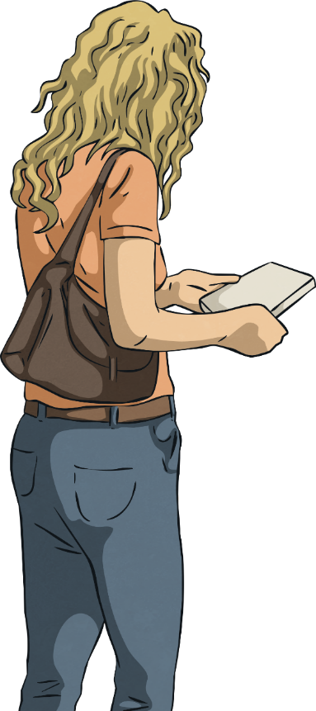
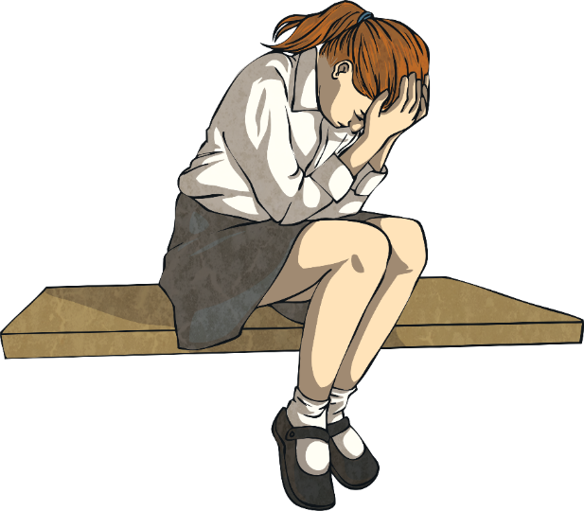
What Is Wellbeing?
When people feel anxious or worried about changes, they will try and control any areas of their life that they can.
This might not be the ‘right’ thing to do but it is often done by people trying to look after their wellbeing in the only way they know how.
When people are dealing with change, they often try and control the only things they can.
This might be what they buy from the shop or what their home looks like.
Today you will learn some other ways to look after your wellbeing, especially in a time of change.

Slide 8
Reconnecting

Slide 9
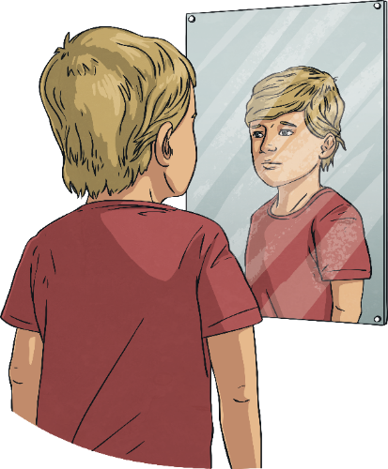
Be Kind
When change is happening in the world around you, or when things feel a bit more difficult, it is important to remember to be kind in what you think, say and do.
This includes being kind to others but also being kind to yourself.

Slide 10
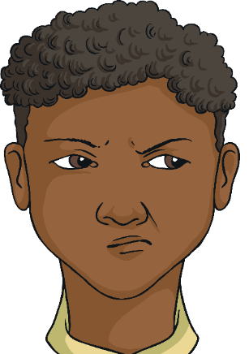
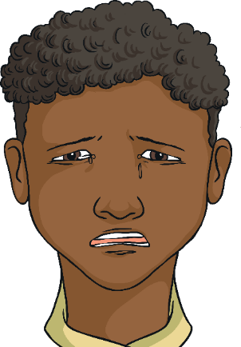
Be Kind
When choosing how to react and respond to other people, it is important to understand why they are behaving in a certain way, as well as their emotions or situation. This knowledge is important for helping you to understand their behaviour and words but also how to forgive and be kind, if necessary.
It is also important to have the same patience and understanding with yourself.

Slide 11
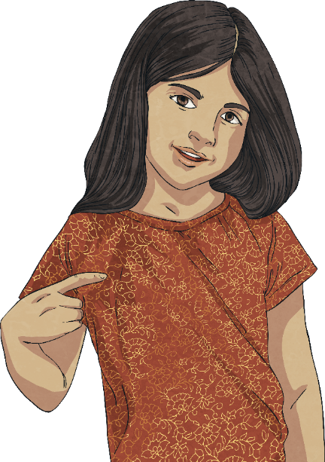
Be Kind
We often take the time to show gratitude to others but it is important, as part of self-care, that we show ourselves thanks and gratitude.
Remember to speak to yourself and about yourself in a way that you would with someone else you care about.
Often, people speak unkindly about themselves, in a way they would never speak about someone else.
It is important to know the effect we have on ourselves and our wellbeing when we do this.

Slide 12
Be Kind
The following checklist contains different ideas and suggestions of ways you can show yourself some self-gratitude.
Ask others to write a positive note about you and pop these in a jar to read to yourself
Plan a day for doing no homework at all and fill it with relaxing or fun games instead.
Surround yourself with people who motivate and inspire you. This is both in person, in the news and online.
Buy yourself a treat with your pocket money.
Which of these could you do today?
Ensure there is something or someone in your life that you care about and that needs your love and care; this could be family, pets or plants.
Write down positive thoughts about yourself and say these out loud
If anyone says anything negative about you, or to you, try and think of a positive about yourself to balance that view.
Spend some time reading a book or listening to your favourite music.
When someone pays you a compliment, make sure you say ‘Thank you’ rather than responding with a self-criticism or by ignoring it. It is important to accept a compliment.
Massage your hands or have a bath. Do something which relaxes you and allows you to rest.
Spend some time outside and enjoy the world around you.

Slide 13
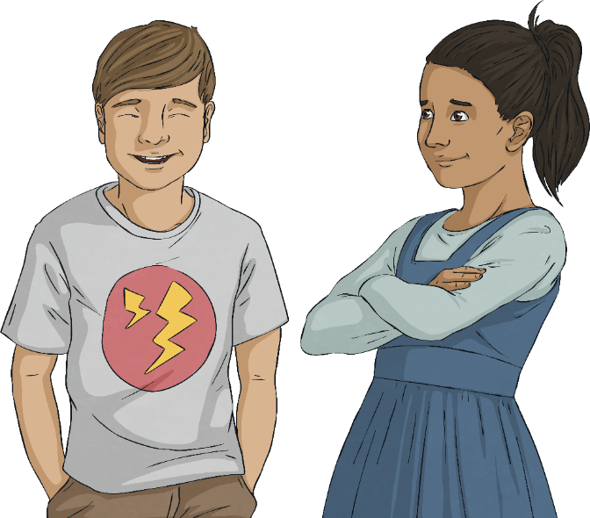
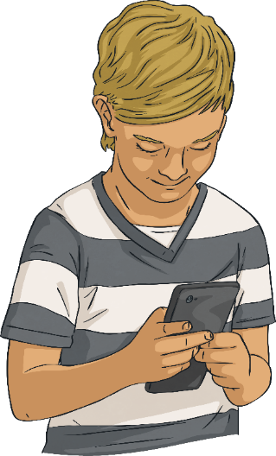
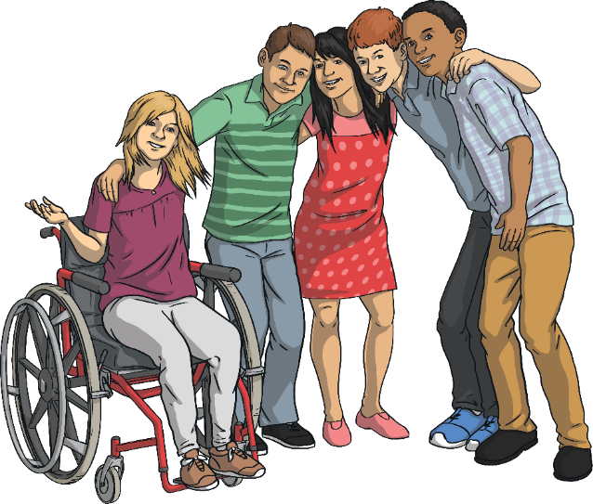
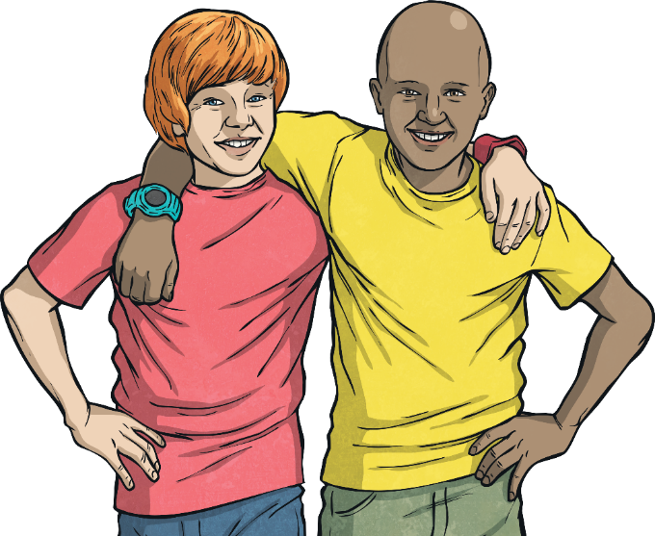
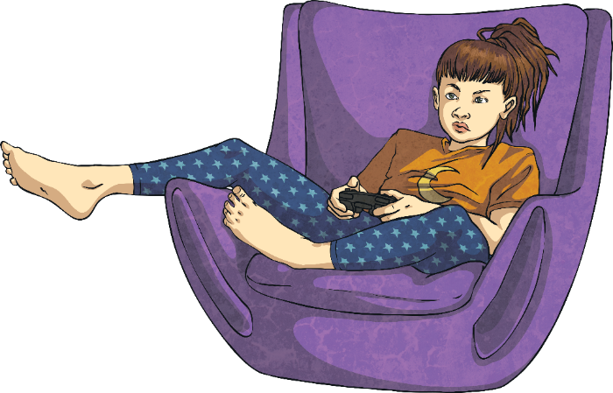
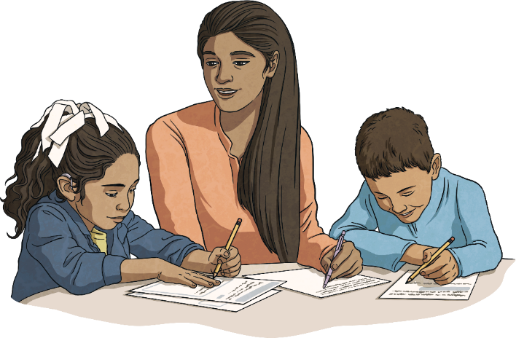
Connect with Others
An important part of wellbeing is being connected with other people. This is called a support network. You will be part of other people’s support networks, where you will support their wellbeing, and other people will be in your support network. This might include family, friends, teachers at school and members of the community.
If you are having difficulties with your wellbeing, it is really important to reach out and connect with someone in your support network.
Connections are a really important part of your wellbeing and for these to be strong, you need to put time and energy into creating and keeping these. It isn’t always easy but it is important for you to have others that look out for your wellbeing and support it.
This might be through face-to-face interactions or, if this is not possible or you’d prefer it a different way, it could be through letters, messaging, telephone calls, video calls or playing games together on the Internet (always check with your parents or carers first if you want to go online).

Slide 14
Exploring

Slide 15
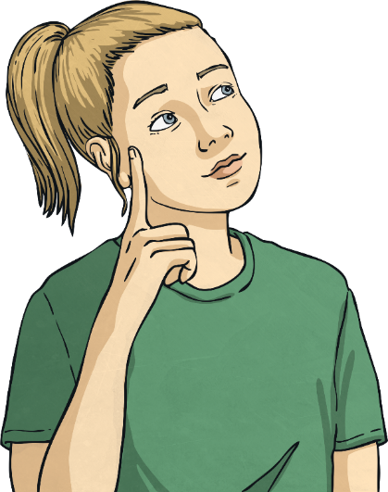
Positive Mindset
Part of coping with times of change or stress is ensuring that the way you see the situation is through a positive mindset.
This means looking for opportunities in every situation, no matter how challenging or difficult they are.
This approach can help you to:
see life in a different way;
think about the priorities in your life;
value people over ‘things’;
remember what is important in your life;
know how important your health and wellbeing are; and
know how important it is to love others and be loved.

Slide 16
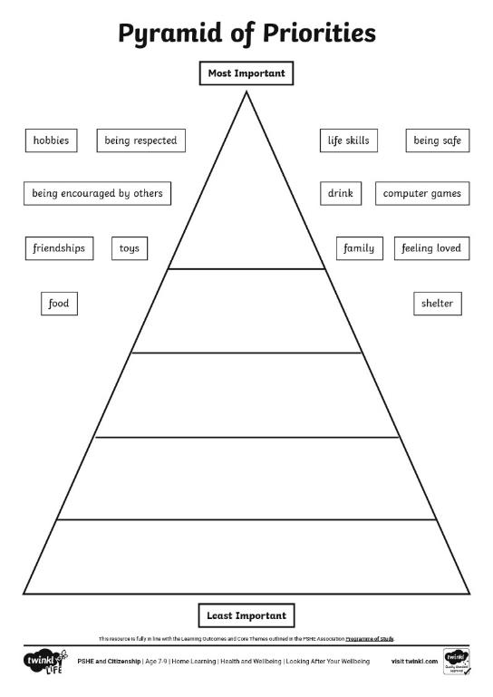
Positive Mindset
Look at the pyramid. Think about where you would put each of the different things in your own pyramid.
Discuss this with someone else in your house and see if there are areas where you feel the same and areas where you differ.

Slide 17
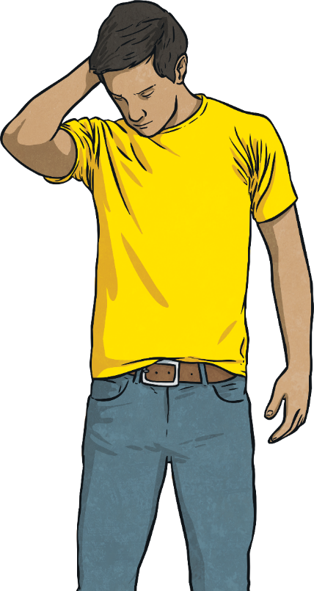
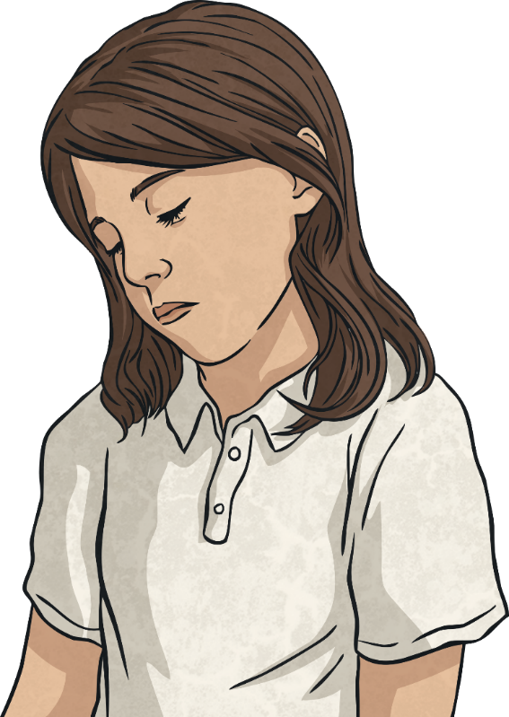
Areas of Control
It is important to break down your thoughts and worries into things you can actually control and things where you have no control.
Lots of people spend time worrying about things that they actually have no control over.
Because they have no control, they can’t do anything to make it better so it can become a big area of worry. This can affect how they feel or how happy they are.
This can help you to realise what you should spend your time thinking about and working on.
It also helps you to identify the things that you need to stop thinking about, or trying to do something about, as you have no control over them.

Slide 18
Areas of Control
Things I Can Control
Things I Can’t Control
getting older
what other people think
traffic
who I play with
the weather
what other people do
my self-care
what I eat
what other people say
what I wear
my opinions
my thoughts
other people’s opinions
my words
what I say
what I do
what other people believe
my actions
how other people feel
Talk about where you would put each thing.

Slide 19
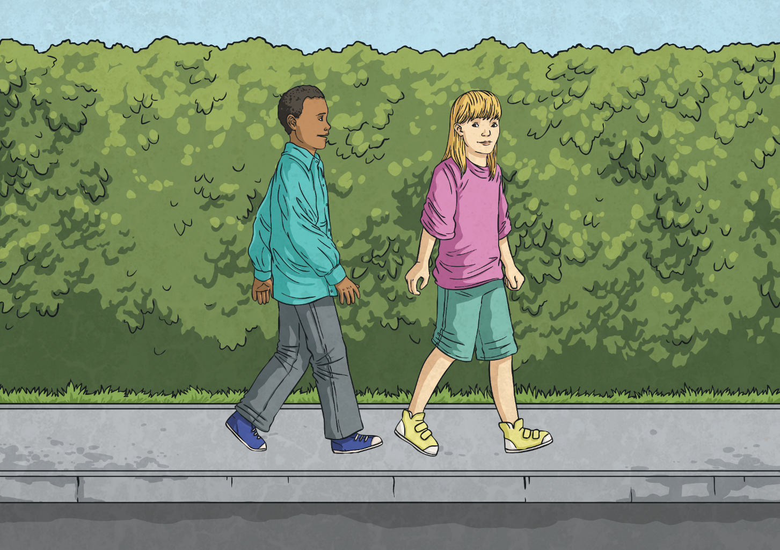
Consolidating
Reflecting

Slide 20
Consolidating

Slide 21
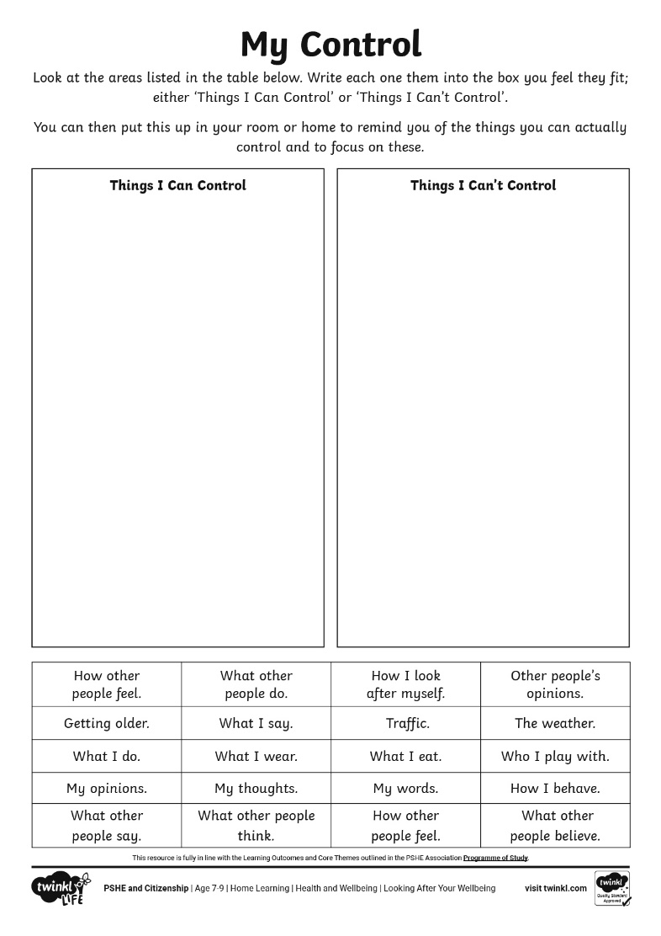
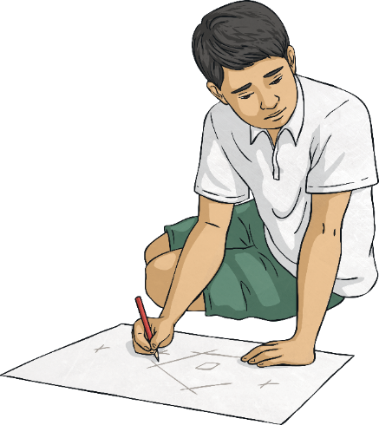
My Control
Using your My Control Activity Sheet, create a reminder of what you can and can’t control to display in your home.

Slide 22
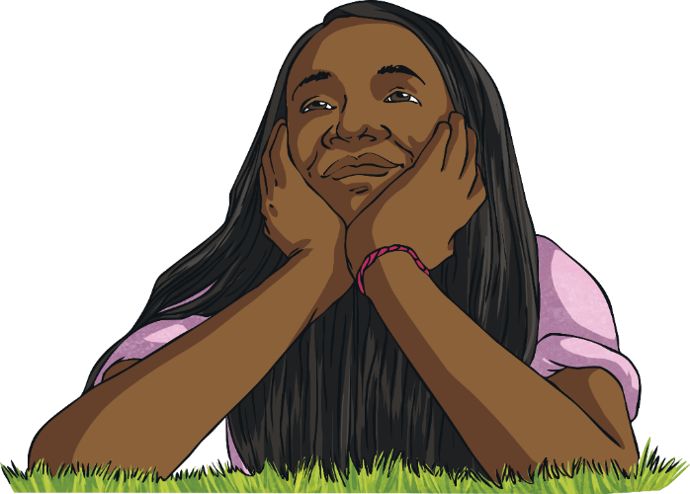
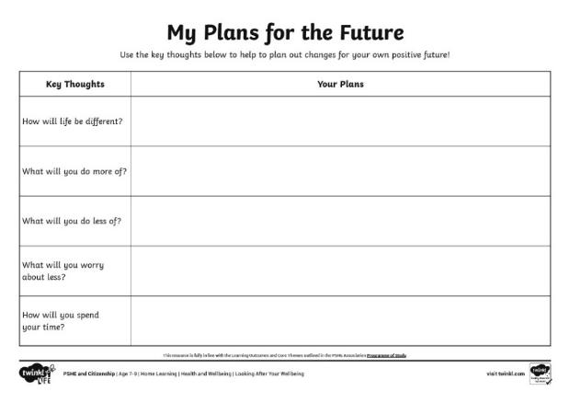
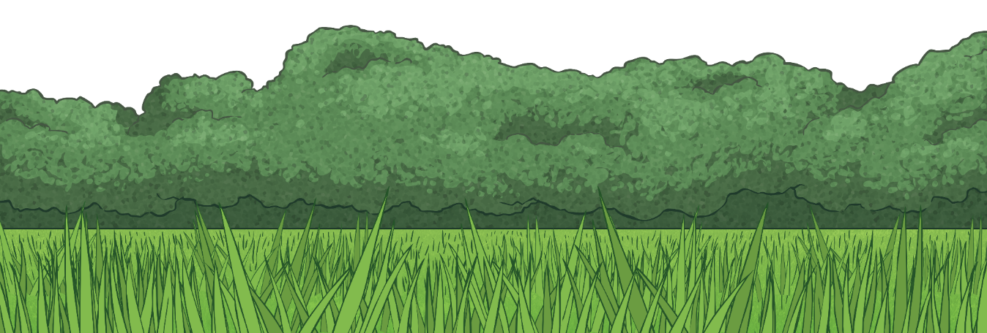
The Future
Think about:
How will life be different?
What will you do more of?
What will you do less of?
What will you worry about less?
How will you spend your time?
Use the My Plans for the Future Activity Sheet to help you with these thoughts and ideas.
Whenever you are going through changes or a difficult time, it can feel hard to see beyond the day you are living in or to see that things can change.
While it can help to think about one day at a time, it can also be helpful to think about the future in a positive way as well.
These thoughts can help you to see the positive that can come from even the most difficult situations.

Slide 23
Reflecting

Slide 24
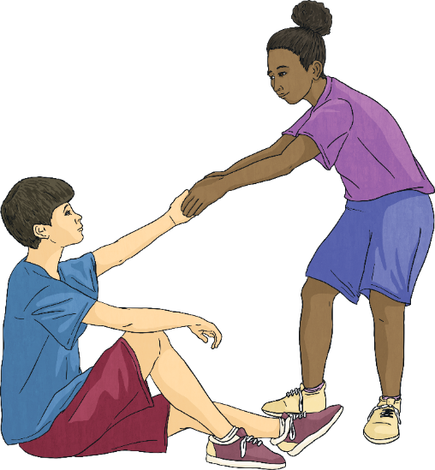
Support Networks
When you are looking after your own feelings and happiness, it is important to realise how much other people can help and support you.
As well as this, you can be there to support and help others. Often, thinking about other people helps your own wellbeing, as it helps you to feel good and positive.
Helping other people can make you feel needed and your help to them creates a support network for you when, or if, you need it.
It is important to reach out to others and say when you need help and support.
Remember, other people will feel good from helping you.

Slide 25
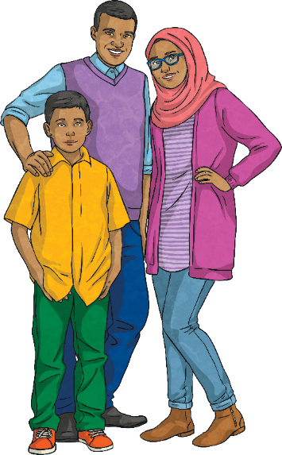
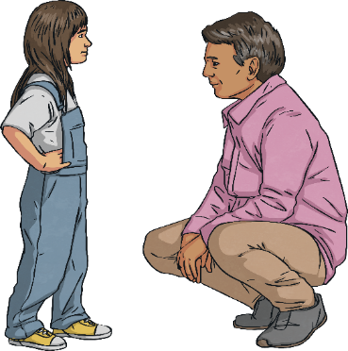
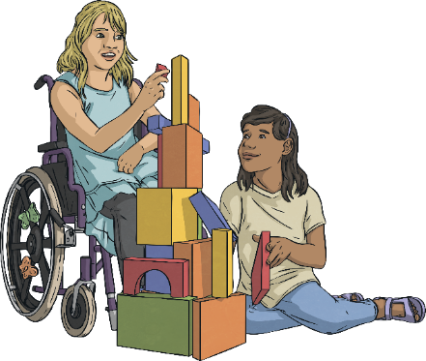
Support Networks
This could be:
family members;
friends;
teachers;
other adults;
support workers; or
online support sites (always check these with a grown-up).
Think about the people who are there to support you.
Using the Support Network Web on the next slide, write the names of every single person within your support network so you know all the people who are there to support you.

Slide 26
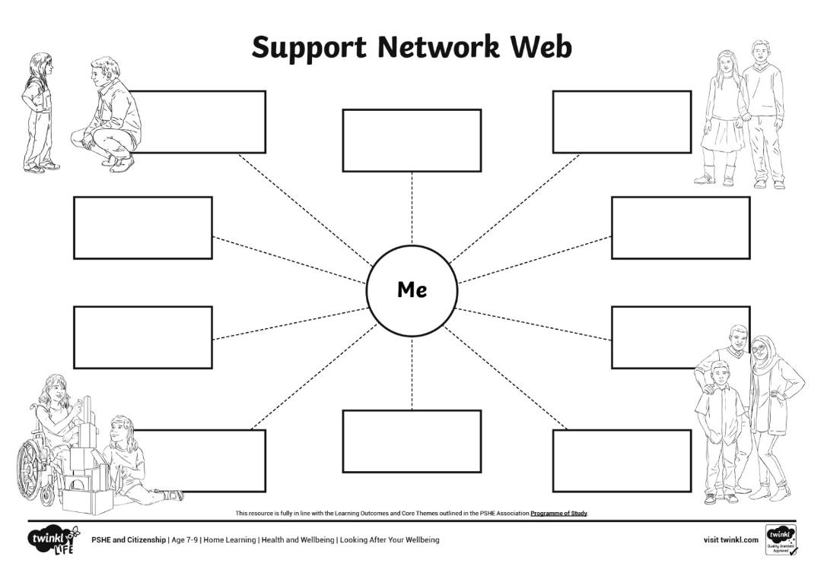
Remember, you can go to anyone you feel comfortable talking to within your support network.

Slide 27
The Big Questions

Slide 28
What is wellbeing?
How can I look after my own wellbeing?

Slide 29
Aim
I understand that there are strategies and behaviours that support my mental health and wellbeing.
Success Criteria
I can think of ways I can be kind to myself.
I can list the things I can control and the things I can’t control.
I can think of ways to connect with other people for support.
This resource is fully in line with the Learning Outcomes and Core Themes outlined in the PSHE Association’s Programme of Study.

