Slide 1
Prepositions and adverbs
Notes:
All these slides are based on the teaching outlined in the document ‘Teaching_1_Pronouns’ available from Hamilton.
It is essential to read the teaching before using this powerpoint presentation.

Slide 2
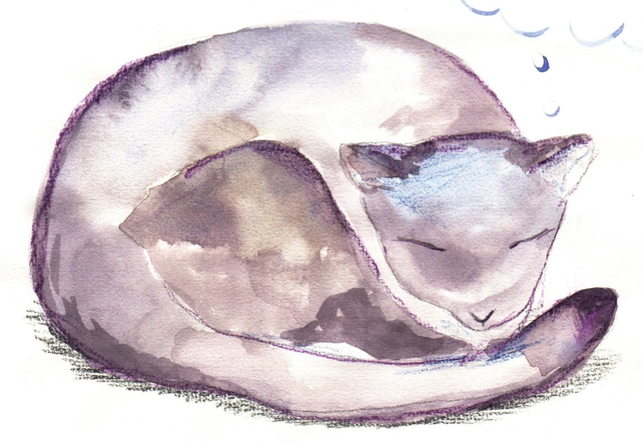
Prepositions

Slide 3
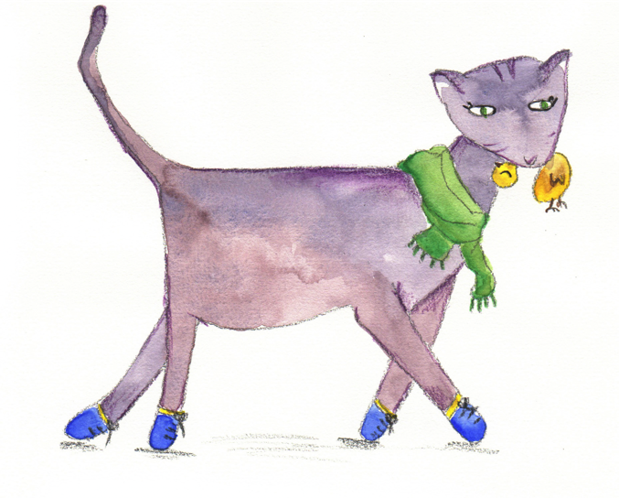
Verbs
Verbs indicate that someone or something is
doing, feeling or being.
Hermione reads.
A shadow looms.
The cat appears.
I laughed!
Usually verbs have the name of a person or thing or a pronoun
in front of them.
Revision

Slide 4
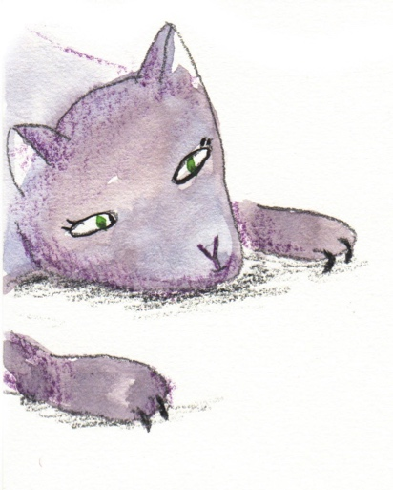
Phrases
A phrase is a group of words which adds meaning to a sentence.
behind the library shelves
with my owl
during the night
because of the spell
There is no active verb in a phrase.
Revision

Slide 5
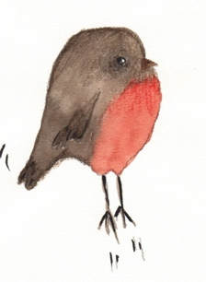
Prepositions
Prepositions tell us how words are related.
above
over
when
because of
before
between
on
from
due to
in
since
outside
inside
during
from
where
under
on
why or how
at
after
for
below
Can you see a pattern in the grouping of these prepositions?

Slide 6
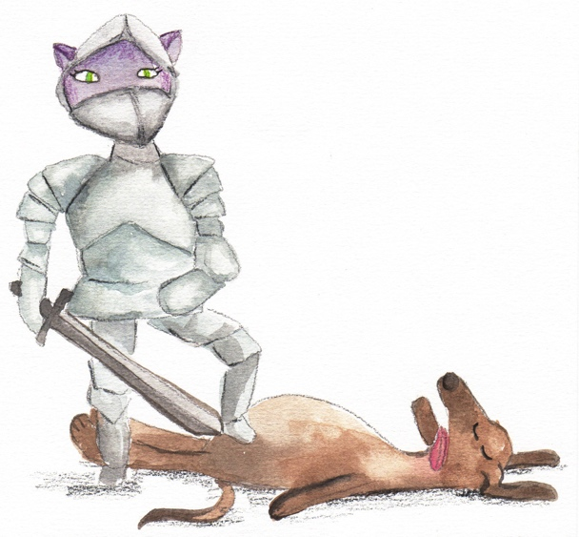
Prepositions
Prepositions link a phrase to a sentence.
I think there is someone
behind the dog!
I explore Hogwarts
with my friends.
They followed the teacher
to the classroom.
The suit of armour came
away from the wall.

Slide 7
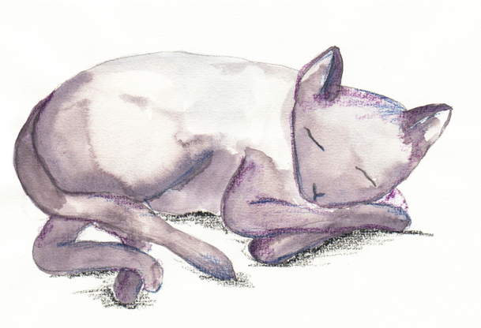
Prepositions
Prepositions tell us abouttime, place and cause.
when
, where
and why or how.
When?
We found Mrs Norris
at dawn.
We found Mrs Norris
during the day.
We found Mrs Norris
after breakfast.
Prepositions
while, since,
before, during, after, at, on
Try adding your own prepositional phrase to tell us when.

Slide 8
Prepositions
Prepositions tell us aboutme, place and cause.
when ,
where
and why or how.
Where?
We found Mrs Norris
outside the library.
We found Mrs Norris
below the castle.
We found Mrs Norris
in the forbidden forest.
Prepositions
above, below,
inside, outside, on, in, between
Try adding your own prepositional phrase to tell us where.

Slide 9
Prepositions
Prepositions tell us abouttime, place and cause.
when,
where and
why or how.
We found Mrs Norris
from our careful search.
How?
We found Mrs Norris
due to sheer luck.
Why?
We found Mrs Norris
because of the spell.
How?
Prepositions
because of, due to,
from, for,
Try adding your own prepositional phrase to tell us why or how.

Slide 10
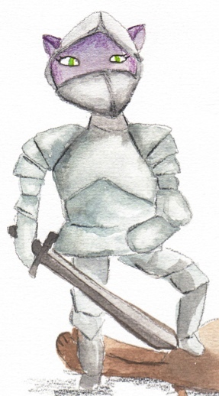
Prepositions
Prepositions can be used at the beginning or end of a sentence.
Something is hiding
something is hiding.
inside the suit of armour.
Inside the armour,
I try out spells
I try out spells.
with my friends.
With my friends,
They followed Mrs Norris
they followed the cat.
down the corridor.
Down the corridor,
She did not notice
because of the cloak
over our heads.
Can you make a new sentence by swapping the phrases?

Slide 11
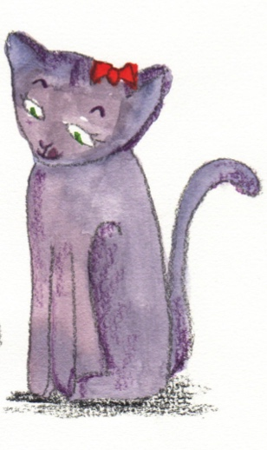
Adverbs

Slide 12
Adverbs
Verbs are doing, being or feeling words.
run
fly
think
speak
An adverb tells you more about a verb.
quickly
steadily
carefully
loudly
fly steadily
think quickly
speak carefully
Try modifying one of the verbs with one of the adverbs?
Revision

Slide 13
Adverbs
Some adverbs do not end in ly.
tomorrow
then
now
soon
here
there
They can still tell you more about a verb.
Where?
I lost my broomstick
here.
When?
I want a cat
now.
Try modifying one of the verbs with one of the adverbs?

Slide 14
Adverbs
Adverbs tell us about when, where and why or how.
When?
The cat slept
daily.
The cat slept
earlier.
The cat slept
yesterday.
The verb ‘slept’ is modified by the adverbs.
Can you think of any other adverbs which answer the question: When?

Slide 15
Adverbs
Adverbs tell us about when, where and why or how.
Where?
The cat walked
here.
The cat walked
there.
The cat walked
outside.
The verb ‘walked’ is modified by the adverbs.
Can you think of any other adverbs which answer the question: Where?

Slide 16
Adverbs
Adverbs tell us about when, where and how or why.
The cat watched
silently.
How?
The cat watched
intently.
The cat watched
avidly.
The verb ‘watched’ is modified by the adverbs.
Can you think of any other adverbs which answer the question: How?

Slide 17
End

