Slide 1
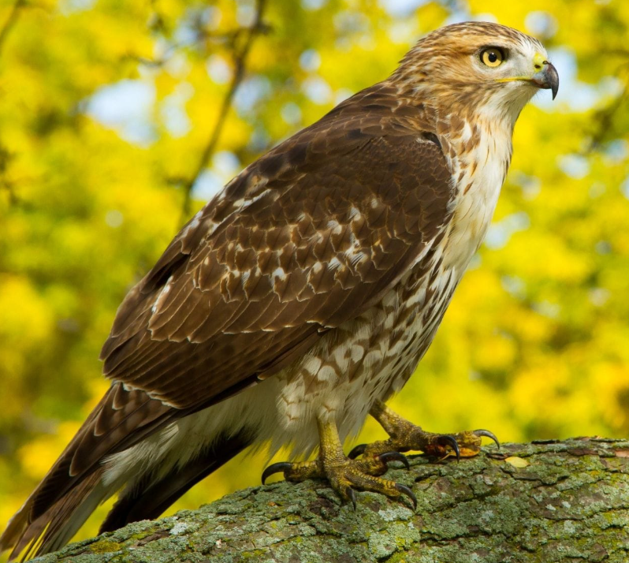
Welcome to Hawks!

Slide 2
Hawks Teaching Team
Miss Rackstraw (Mondays, Tuesdays, Thursdays, Fridays)
Ms Charlotte Crowther (Wednesdays)
Miss Lucy Spencer (Monday, Tuesday, Wednesday and Fridays)
Mrs Emma Spencer & Miss Phillipa Armstrong (Thursdays)

Slide 3
Curriculum Areas
English
Mathematics
Science
History and Geography
Art and DT
French
Physical Education
Religious Education
Computing
PSHE
Music (Term I)
Forest School (Term II)
Please see the curriculum letter for more details around what the children will be covering in each subject. A timetable is also available on the class page of the school website.

Slide 4
Topic Areas
During the course of the year, we will cover several different topics. These will include:
Anglo-Saxons
All Around the World
Crime and Punishment
Ancient Greeks
Exploring Eastern Europe
Water
Notes:
Anglo- Saxon day
Lady Ryder Memorial Garden- 13th October
Oxford castle in the Spring term
Summer term RE trip.

Slide 5
Homework – Weekly tasks
English and maths will be set on a Monday by Miss Rackstraw
English task
Maths task
Spelling task
The English task will be to complete a comprehension activity. This will be sent home in a CGP workbook with details of which activity to complete.
The workbook will need to be back in school by the following Monday for whole class marking and discussion.
The maths homework task will be to complete a set of assigned units on mathletics.
This will also need to be completed by the following Monday.
Spelling homework will be set on Wednesdays by Ms Crowther.
Spellings will need to be learnt for the following Wednesday, as this is when they will be tested.
Notes:
Maths and English Homework will come home in a paper folder, I will put the mathletics log ins in here, to be back in school every Monday, ready for Homework to be marked and set. Homework will start this coming Monday, reading books and spelling starts have already gone out.

Slide 6
Homework – Daily reading
Children are also expected to be reading on a daily basis.
They have already received a reading record to document this in.
Children are expected to hand in their reading record every morning, along with the book that they are currently reading. This should document the reading that they completed the night before. This is checked daily.
To encourage engagement with their daily reading, each month your child will receive a reading bingo card (it will be stuck into the back of their record). If they can tick off all the items and get it signed by an adult, they will earn 5 house points.
We do check reading records every morning, please write in the reading diaries if your child is going home with someone else.
Notes:
We do check reading records every morning, please write in the reading diaries if your child is going home with someone else.

Slide 7
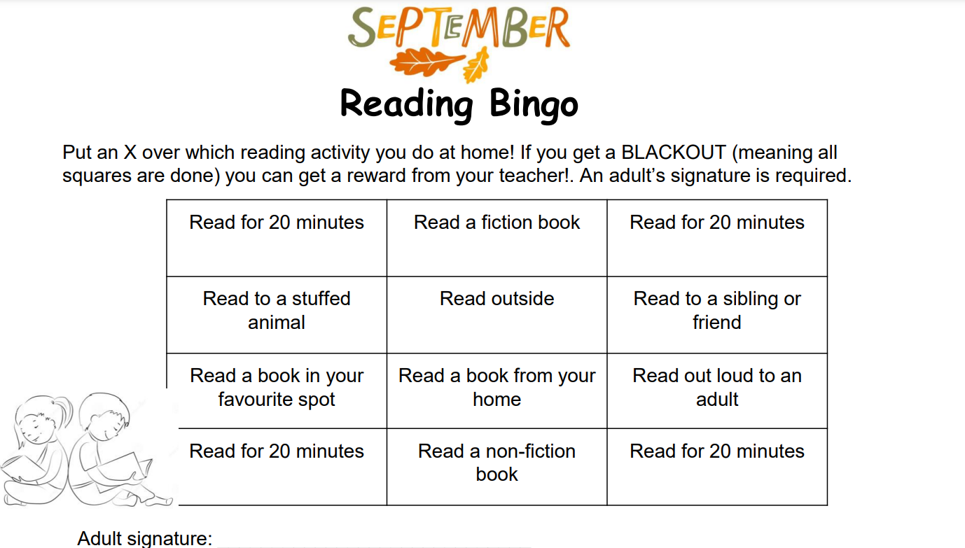
Notes:
I will change and check these every month.

Slide 8
Homework – Spelling Stars
Spelling Stars
Children have already completed this half term’s baseline assessment of their Spelling Star with Ms Crowther.
They should have a copy from last Wednesday, with the words that they need to practise highlighted.
Children will be retested on their Spelling Star at the end of each half term; please support your child in making sure that they are practising these words in addition to their other homework.

Slide 9
Homework
Maths Passports
We will continue to work on the times table maths passports on a regular basis in school.
Where possible, please also continue to support your child at home by making sure they are secure and confident in their times table knowledge.
If children are having difficulties with homework, please let me know, so that we can go over it again with them.
Notes:
If anyone has any maths passports at home please return them.

Slide 10
PE
During the autumn term, the class will be having 2 PE lessons per week, as follows:
Autumn I: Tuesday- Gymnastics with Miss Rackstraw, Wednesday – Games with Premiere Sport.
Autumn II: Tuesday – Games with Miss Rackstraw, Wednesday- Forest School.
PE Kit
T shirt with school logo or plain white T shirt
Royal blue or black shorts
Trainers or plimsolls
Royal blue or navy sweatshirt and jogging bottoms
Notes:
Keep PE kit in school for the whole of half term.
Swimming In the summer term.

Slide 11
Uniform
At Frieth, we believe that the school uniform contributes to our school ethos and instils a sense of belonging to the school. We ask our children to take pride in their appearance and to look smart in school.
School sweatshirt / plain royal blue cardigan or jumper
White or pale blue polo shirt
Black or grey skirt or trousers
White, grey or black socks / black tights
Fleece for outdoor wear (optional)
Black low-heeled shoes. Boots are not allowed.
In the summer, pupils may choose to wear a royal blue and white checked dress or shorts.
Notes:
Pencil cases!

Slide 12
Communication
It is very important that the children feel they can talk to their teachers if they have a worry. If they feel they can not approach directly, all classes have a ‘Communication Box’ which the children can place a note in.
If you as parents have any concerns, please feel free to see me on the gate at the end of the day or send me an email to rrackstraw@friethschool.co.uk

Slide 13
Any Questions?
Feel free to come and ask any questions afterwards.
Notes:
PARKING

