Slide 1
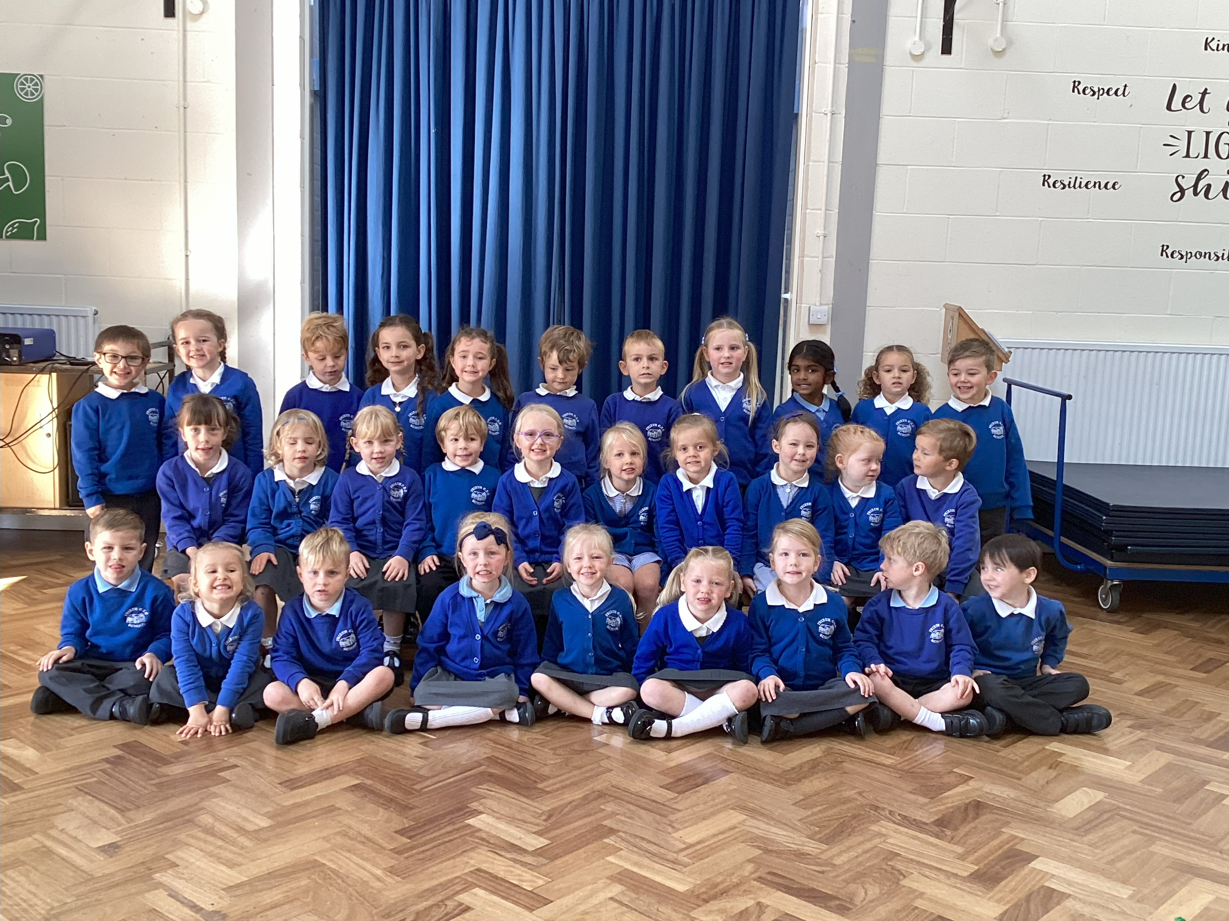
Welcome to Owls!

Slide 2
Owls Class Staff
Mrs L Goodchild – Class Teacher
Mrs S Bryan – LSA (Monday – Thursday)
Miss P Armstrong – LSA (Friday)
Mrs E Spencer – PPA Cover (Monday pm and Wednesday am)
Miss Catherine – Forest School Leader (Wednesday mornings, second half of term)

Slide 3
The areas of learning and development in EYFS
THE PRIME AREAS:
  • communication and language
  • physical development
  • personal, social and emotional development
THE SPECIFIC AREAS:
  • literacy
  • mathematics
  • understanding the world
  • expressive arts and design
Please see the curriculum letter for more details about what the children will be covering in each subject.

Slide 4
Reception Baseline Assessment
(RBA) 2025
Your child will be participating in the RBA within the first 6 weeks of starting reception.
The RBA is not about judging or labelling your child or putting them under any pressure. Your child cannot ‘pass’ or ‘fail’ the assessment. Its main purpose is to create a starting point to measure the progress schools make with their pupils.
When your child reaches the end of key stage 2, you will be able to see how well your child’s school has supported the year group in their time at primary school, compared to other schools nationally.
Your child’s teacher will receive a set of statements, which provide a narrative description of how your child performed in the assessment.

Slide 5
Uniform
At Frieth, we believe that the school uniform contributes to our school ethos and instils a sense of belonging to the school. We ask our children to take pride in their appearance and to look smart in school.
School sweatshirt / plain royal blue cardigan / jumper
White or pale blue polo shirt
Black or grey skirt or trousers
White, grey or black socks / black tights
Fleece for outdoor wear (optional)
Black low heeled shoes / sandals without open toes. Sling backs are not allowed.
In the summer, some pupils choose to wear a royal blue and white checked dress or shorts
Please ensure that all clothing that your child wears or brings
into school, is clearly named with their own name.
Lost property items from the term so far are available at the back for you to check.

Slide 6
Equipment in school
EVERY DAY
  Bookbag
  Reading Wallet (reading book and reading record)
  Word tins
  Letters/notes/permission slips in Reading Wallet
  Water bottles
  Spare clothing in case of accidents
  P.E. kits (these will be sent home at the end of each half term for washing)
Wednesdays in the second half of term – children to come to school wearing their Forest School kits. Please bring wellies in a separate bag to change into, if they do not have any in school.
SAFEGUARDING
Please write a note and give to myself or the LSAs if there is a change in end
of day arrangements.

Slide 7
P.E.
The class will have two P.E. lessons per week.
These will take place on a Monday and a Friday. Please make sure that your child is wearing uniform which they can easily remove and put back on, on these days.
P.E. Kit
White T-shirt with school logo or plain white T-shirt
Royal blue or black shorts
Trainers
Royal blue or navy sweatshirt and jogging bottoms

Slide 8
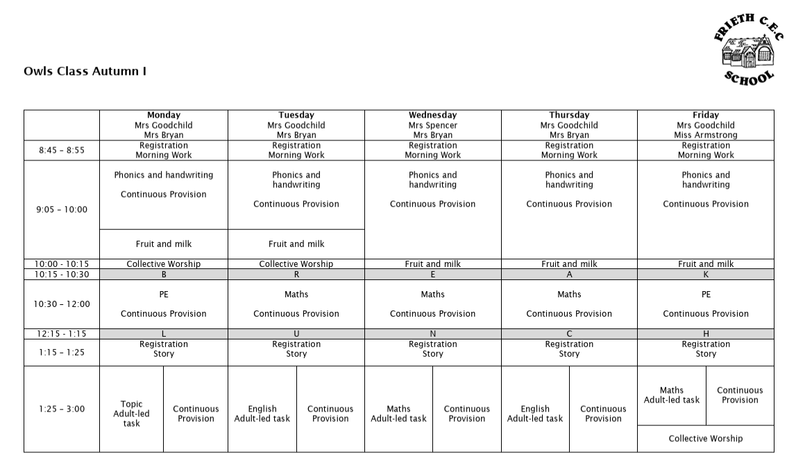
Timetable – Autumn I

Slide 9
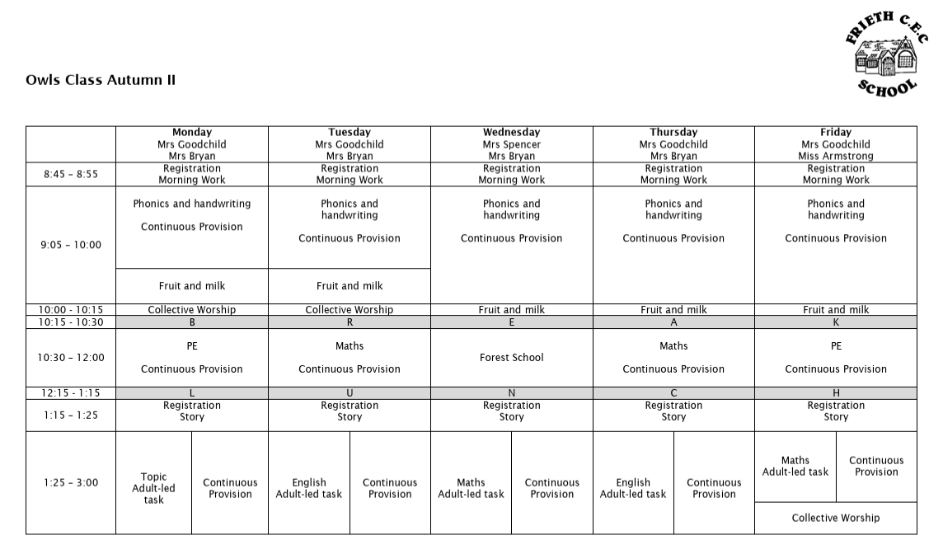
Timetable – Autumn II

Slide 10
Rewards and Sanctions
Rewards:
Sanctions:
House Points
    Attenborough
    Rashford
    Rowling
    Nightingale
Rainbow
Headteacher’s Award
‘Let Your Light Shine’ certificates
Stickers
Class mascot
Verbal Warning
Behaviour Chart
Minutes off playtime
Sent to SLT
Note/call home

Slide 11
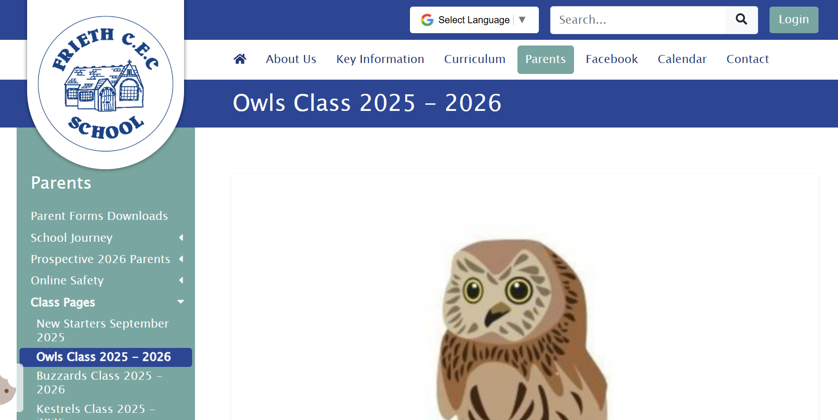
The school website
https://www.friethschool.co.uk

Slide 12
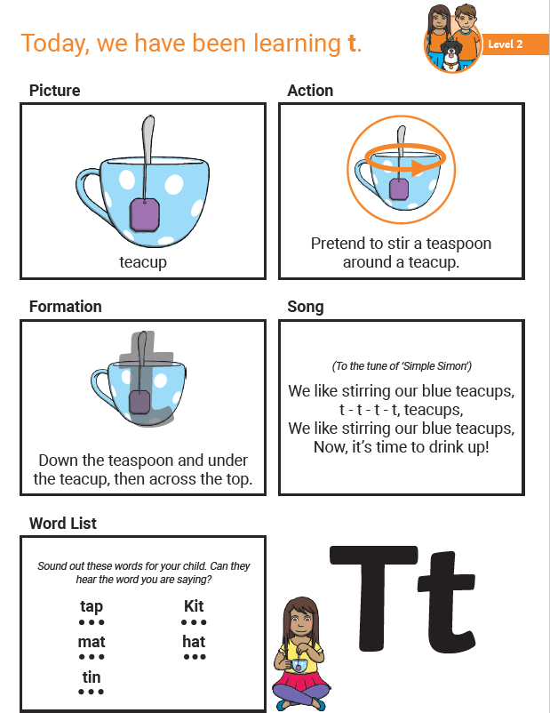
Phonics – Parent Information Sheet
Each week, we will send home a leaflet sharing with you the phonic sounds your child has learn in school that week.
This will provide an opportunity for you to reinforce these sounds with your child, when you are at home.

Slide 13
Homework for EYFS
Homework tasks:
  Daily reading
  Maths Seeds
Reading book(s) and Reading Records will be checked every day in school.
The expectation is that all children should read at home every day
(Monday to Friday).
Maths Seeds is an online platform where children can work through a series of maths tasks, which are tailored to their individual ability levels. Further information about this will be sent out soon.
Further tasks for later in the term:
Word tins with High Frequency Words
Maths passports

Slide 14
Reading at home
Daily reading at home is essential at this age – the more often the better.
Please read the same book 2 or 3 times.
Ask lots of questions about the book – it helps with the comprehension.
We will aim for children to read to the teacher/LSA/Reading Volunteers every day in school, once daily reading starts.
Word recognition 2. Comprehension
Benchmarking
Children will be Benchmarked when they are ready to move up to the next level, both in terms of word recognition and comprehension.

Slide 15
Forest School
On Wednesday mornings in the second half of each term, the class will take part in outdoor Forest School activities with Miss Catherine.
The children need to come to school on these Wednesdays wearing their Forest School kit. They will need to bring their wellies with them to change into, if they do not have a pair in school already.
Parents are asked to provide suitable clothing e.g. warm layers, waterproof jackets and trousers.
At the end of the day the children will be going home wearing their Forest School kits.

Slide 16
Food and Drink
All Early Years and Key Stage 1 children are entitled to a free school meal each day.
Packed lunches should support our school’s healthy eating policy.
Please note that our school is a ‘nut free’ zone which means that all types of nuts are banned.
FIZZY DRINKS are not allowed in school lunches and bottles should be filled with water only.
Children will receive a FREE PIECE OF FRUIT/VEGETABLE during the morning.
Free milk scheme – please liaise with the school office to order your child’s free milk.

Slide 17
Health
Staff need to be aware of your child’s medical background. In particular, any allergies, any dietary restrictions and any medical conditions that are important for us to know (e.g. asthma or eczema). Please let the school office know.
Children can suddenly become ill and therefore it is important that we know we can contact you or another adult relative/friend at all times. Please ensure that the school is kept up to date with your contact details.
If your child is unable to attend school due to illness, please telephone the school office to let us know by 9:30am.

Slide 18
Communication
It is very important that the children feel they can talk to their teachers if they have a worry.
If parents or carers have any concerns, please come and see us at the end of the school day or send a short email.
First aid in school – please note that if your child receives first aid in school, you should receive an email via SmartLog. You do not need to contact the school as a result of this.

Slide 19
Help!
We are always looking for parent volunteers to help with:
Reading Volunteers
Cooking with the class
Trips
Jobs around the EYFS area
If you are available to help, please let me know.

Slide 20
Any Questions?

