Slide 1
Making a diorama box
You will need card, colours, material and scissors.

Slide 2
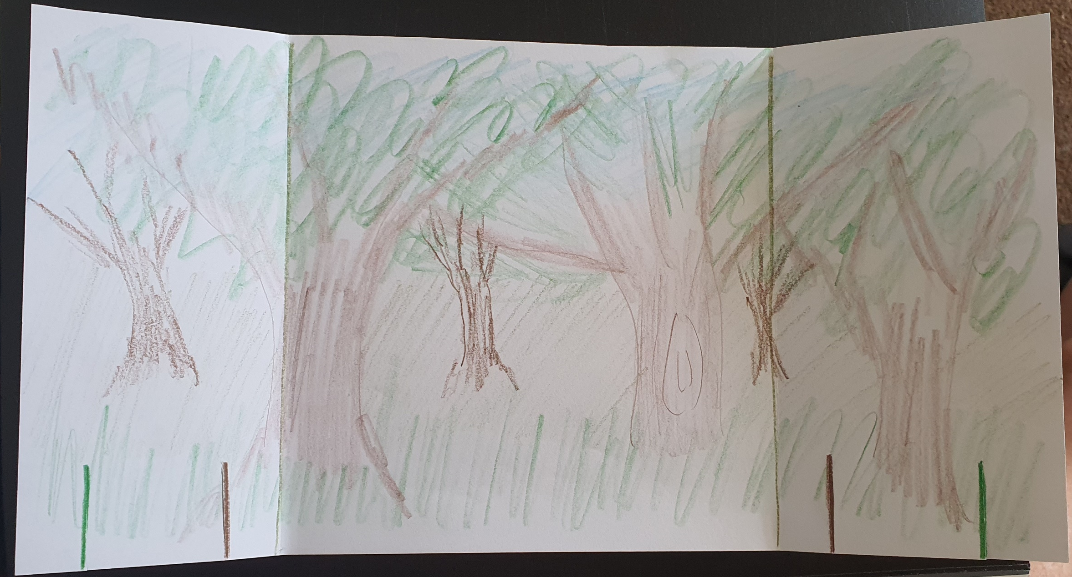
Step one: Make the background.
Get a rectangular piece of card and fold so you have 3 sections. Middle section is your backdrop and end sections are the sides of your stage.
Decorate all sides to represent your scene using colours, pencils, crayons, paint, materials etc.
I did mine vey quickly just to show you what I mean.

Slide 3
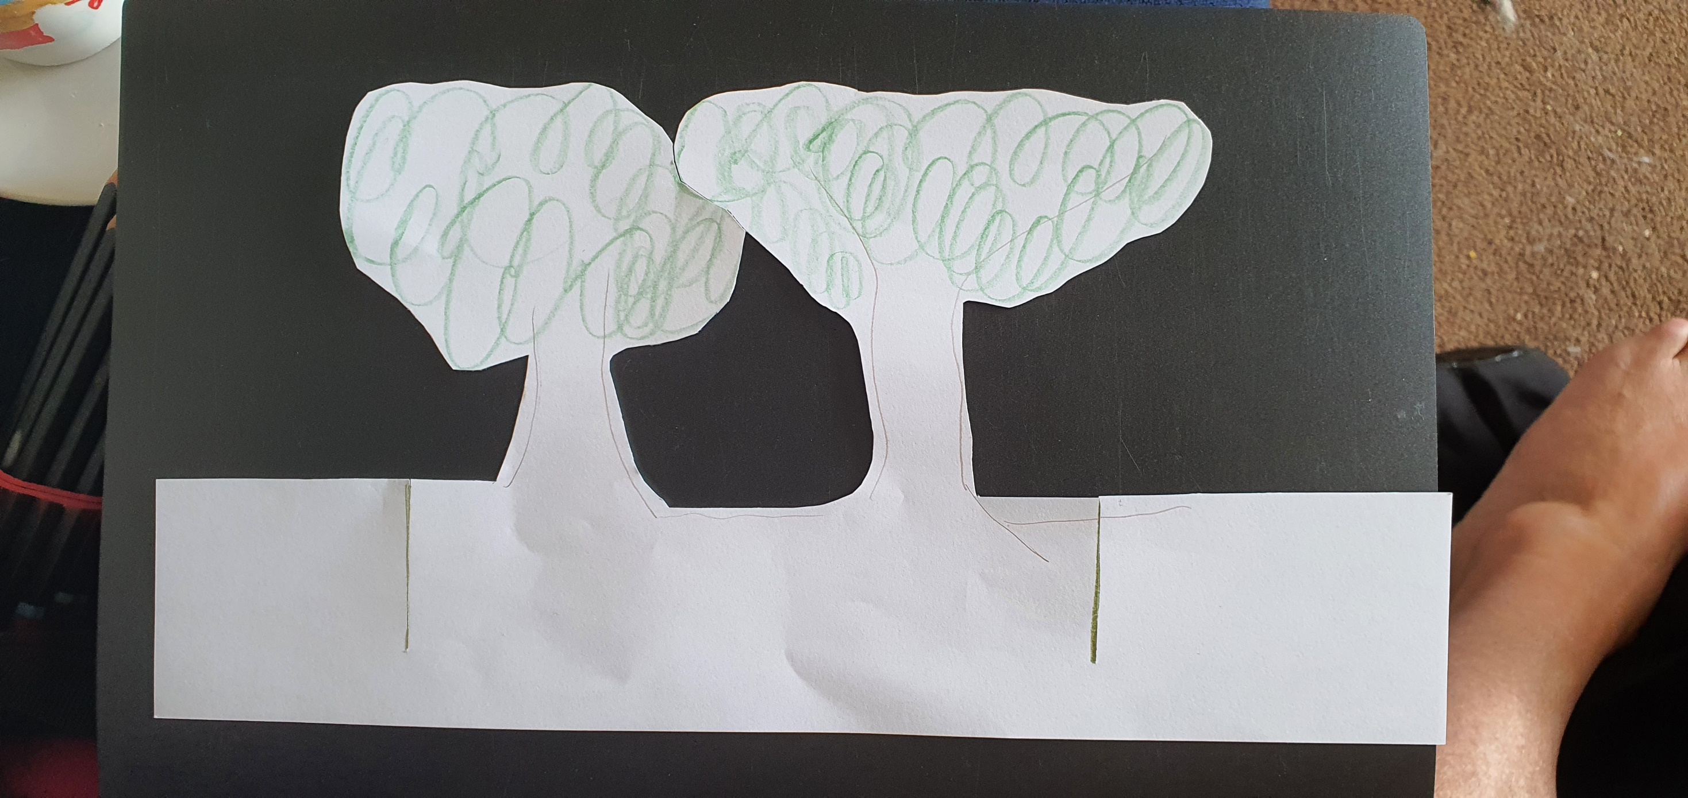
Step 2: Making the layers
This time you are going to create layers which will give your diorama depth. You will need some more strips of card the same length as your backdrop that you are going to draw some features on. I have chosen to do trees as we are in a wood. Once drawn you need to carefully cut them out remembering to leave some end sections where you will join it to your backdrop.
If you look at slide 2 again you will see some shorter lines drawn on the backdrop at the bottom. These are the cuts I have made to slot the layers into. They will also give your diorama a bit of stability so it hopefully won’t fall over.

Slide 4
Layer 2: In the same way as the first layer you are now going to create a second layer which will go nearer the front of your stage. This one should be lower than the other layer but you will still need the same length of card. As before decorate with features from your scene (I have chosen to do grass) cut out carefully again leaving edge pieces to attach to your diorama.

Slide 5
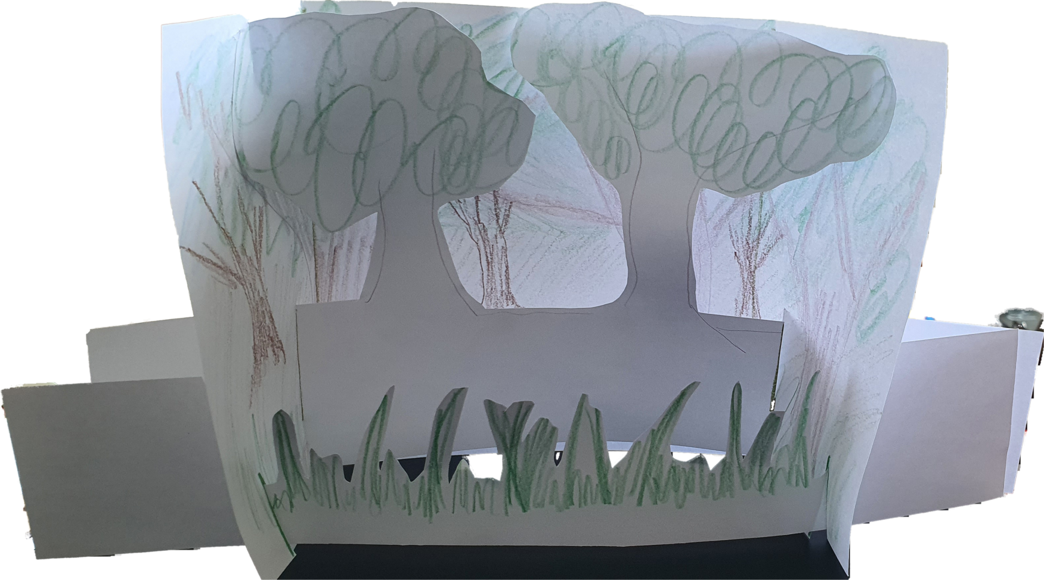
Putting it all together:
Now you have all your pieces and your backdrop you can begin to assemble your stage. You are going to slot the layers into the diorama using those cuts you made in the edges of the backdrop. This should give you a layered effect on your stage that your characters can move between.
Have a look at my final scene box to see what it should look like.
Once we have made our characters you can then use them in between your features to tell your story.

