Slide 1
Welcome back to Hawks!

Slide 2
Hawks Team
Miss Hughes
Mrs Hunt (Monday afternoons)
Premier Sport/Music (Wednesday afternoons)
Miss Crowther – French
Learning support assistant:
Mr Upsher

Slide 3
Curriculum Areas
English
Mathematics
Science
History and Geography
Art and DT
Physical Education
Religious Education
Computing
Music
PSHE
French
Forest School
Please see the curriculum letter for more details around what the children will be covering in each subject. A timetable is also available on the class page of the school website.

Slide 4
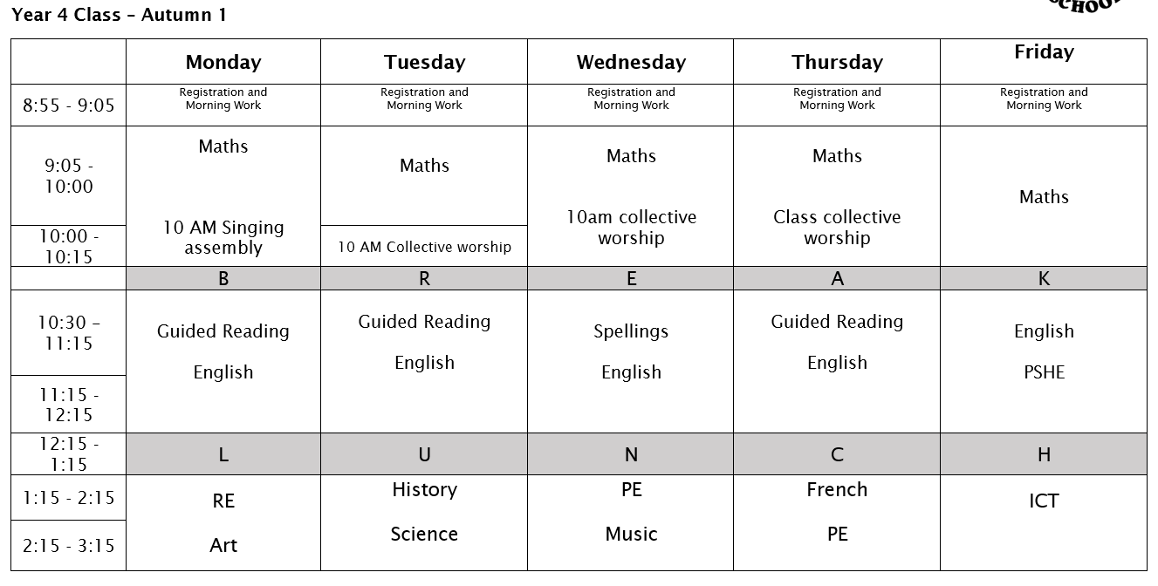

Slide 5
Rewards and Sanctions
Rewards:
Sanctions:
House Points
Rainbow
Special Mention
Head Teacher’s Award
Let Your Light Shine
Verbal Warning
Minutes off break
Sent to SLT
Note/call home

Slide 6
Homework
All homework (apart from spellings)
Monday:
- comprehension task – new CGP book
Mathletics online
Wednesdays:
- Weekly list of 10 spellings to learn for the following week

Slide 7
Homework
Children should also be reading everyday and recording what they have read each day. This will be checked daily in their reading records. Please encourage them to write about their book – it could be a prediction, thought, question etc.
If homework is not completed by the due date, children may be asked to stay in for part of their lunch break and complete some or all of it.
If children are having difficulties with homework, please let me know so that we can go over it again with them.

Slide 8
Homework
Spelling Stars
Children have already completed this half term’s baseline assessment of their Spelling Star.
They will bring home a copy, with the words that they need to practise highlighted.
Children will be retested on their Spelling Star at the end of each half term; please support your child in making sure that they are practising these words in addition to their other homework.

Slide 9
Maths Passports
We will continue to work on the times table maths passports on a regular basis in school.​
Where possible, please also continue to support your child at home by making sure they are secure and confident in their times table knowledge.​
The MTC takes place in June.

Slide 10
Uniform
At Frieth, we believe that the school uniform contributes to our school ethos and instils a sense of belonging to the school. We ask our children to take pride in their appearance and to look smart in school.
School sweatshirt / plain royal blue cardigan or jumper
White or pale blue polo shirt
Black or grey skirt or trousers
White, grey or black socks / black tights
Fleece for outdoor wear (optional)
Black low-heeled shoes. Boots and sling backs are not allowed.
In the summer, pupils may choose to wear a royal blue and white checked dress or shorts.
Long hair tied up/stud earrings only/no jewellery apart from watches

Slide 11
PE kit
T shirt with school logo or plain white T shirt
Royal blue or navy shorts
Trainers or plimsolls
Royal blue or navy sweatshirt and jogging bottoms
Please no hoodies or earrings (can be covered with tape from home)
PE will be on Wednesday and Thursdays

Slide 12
PSHE
At Frieth school PSHE is a taught subject. PSHE is timetabled once a week and delivered by class teachers.
The PSHE curriculum has been designed to ensure pupils receive a relevant and age- appropriate education to support them in their lives now and in the future.
Core theme 1: Mental Health and Wellbeing
Core theme 2: Managing Risk
Core theme 3: Forming respectful relationships
Core theme 4: Money matters
Core theme 5: Me and my body growing up
Core theme 6: Families and growing together
We teach the scientific names of body parts from Year 1 and introduce the following key words through the Christopher Winter and PSHE Association resources:
Year 4 – puberty, life cycle, reproduction, physical, breast, sperm, egg, pubic hair, emotional, feelings

Slide 13
Links to the Church
We are also very fortunate to welcome back Reverend Andy
Our school vision is ‘Let your Light Shine’.
This encourages our children to show the world how wonderful they are, in both the good character and values they display and in their unique qualities and talents.

Slide 14
Trips
Visit to Parmoor (Lady Ryder Memorial Garden) which links with our Science and Geography
Visit to a place of worship
Trip to Oxford Castle in Spring term

Slide 15
MTC
For Year 4 pupils, Multiplication Tables Check will be taking place in w.c. 7th June 2027.
These will cover all the way up to the 12 times tables
Throughout the year, we will work to prepare the Year 4 pupils as best we can for these government tests. This will include the children practicing in class.

Slide 16
Items on the school website:
Autumn timetable
Power Point
MTC assessment information for parents
Admin
Parking considerately/turning circle
Messages in reading records for changes in pick-ups etc

Slide 17
Communication
It is very important that the children feel they can talk to their teachers if they have a worry.
If parents have any concerns, please feel free to see me on the gate at the end of the day, write a note in your child’s reading record or email me directly:
mhughes@friethschool.co.uk

Slide 18
Any Questions?

