Slide 1
PSHE and Citizenship
Relationships | Be Yourself
PSHE and Citizenship | Year 3 | Relationships | Be Yourself | Media-Wise | Lesson 5

Slide 3
Aim
I can explore messages given by the media and decide if they are helpful or harmful.
Success Criteria
I can identify some of the ways that the media tries to influence the way we feel.
I can reflect on the reality of the messages given by the media.
This resource is fully in line with the Learning Outcomes and Core Themes outlined in the PSHE Association’s Programme of Study.

Slide 4
The Big Questions

Slide 5
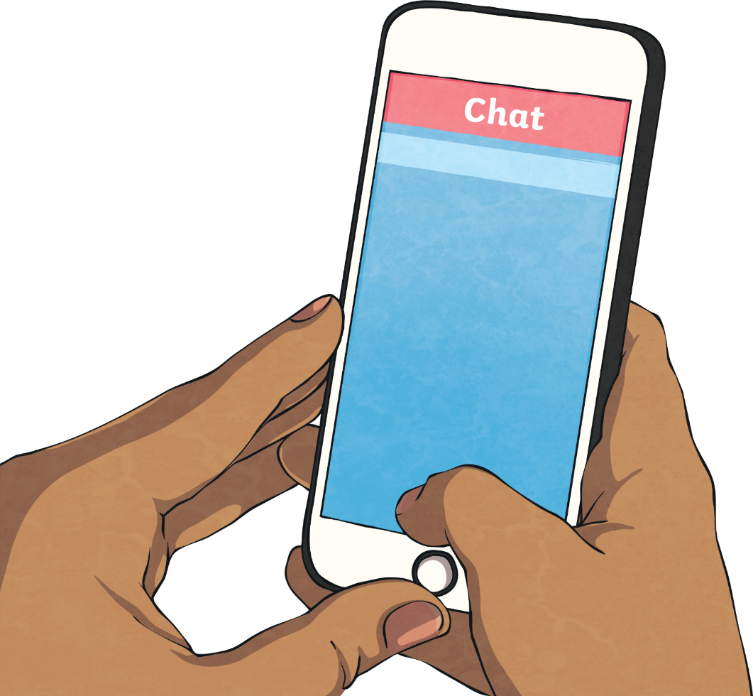
The Big Questions
What messages do we get from the media about how people should look, feel and behave?
Are those messages realistic?

Slide 6
Reconnecting

Slide 7
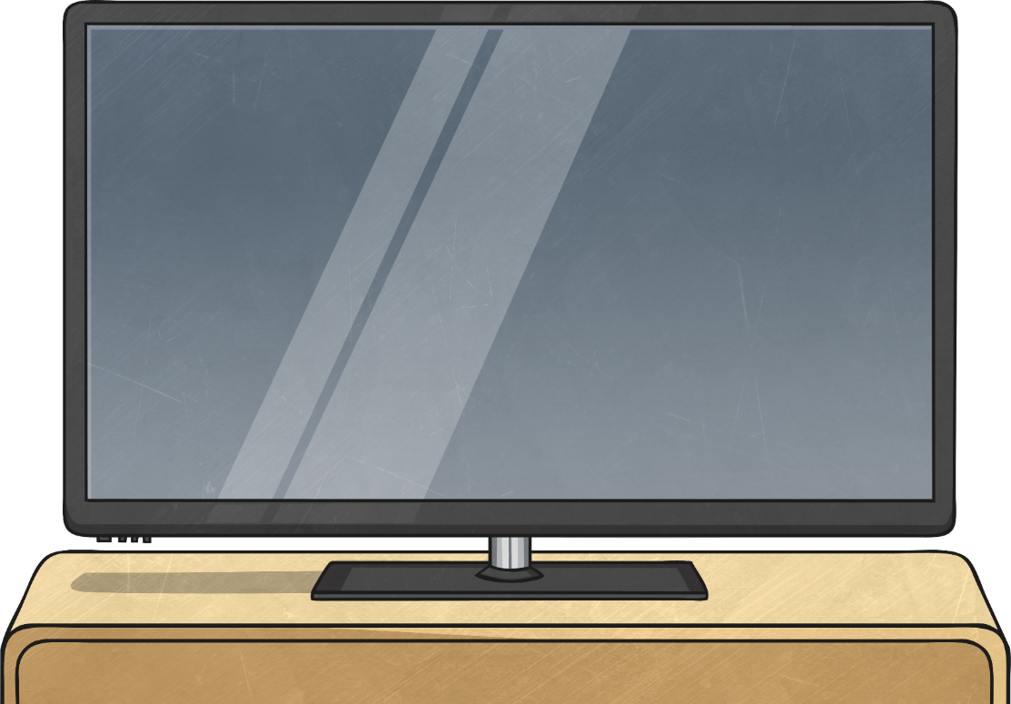
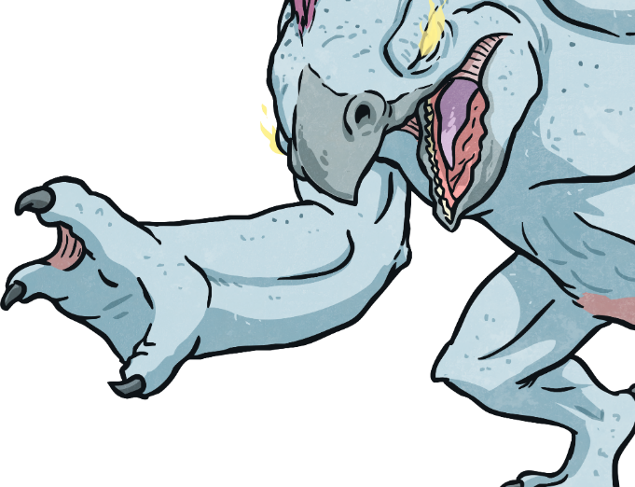
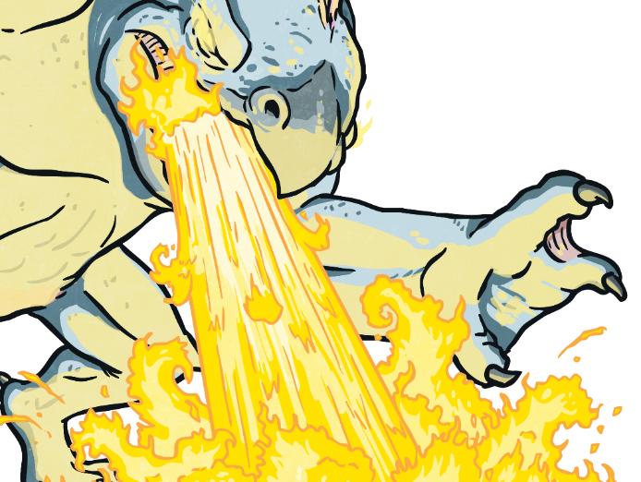
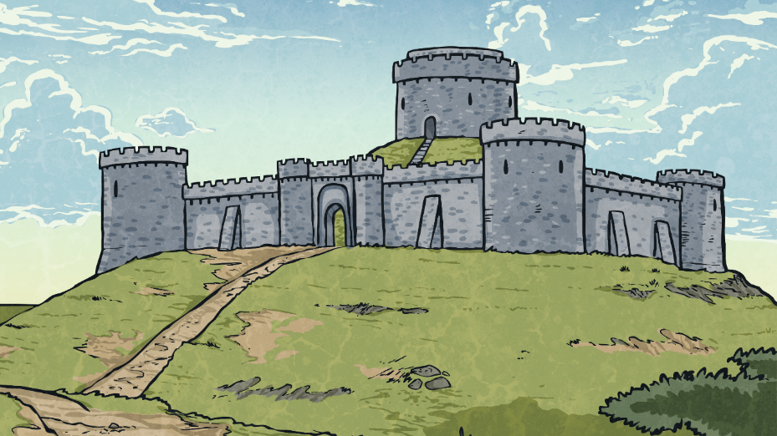
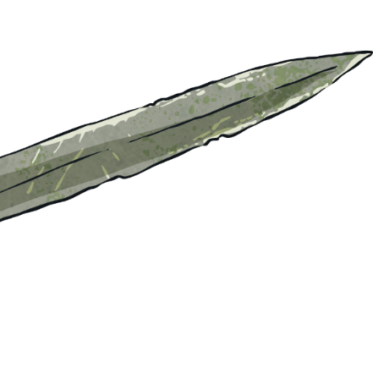
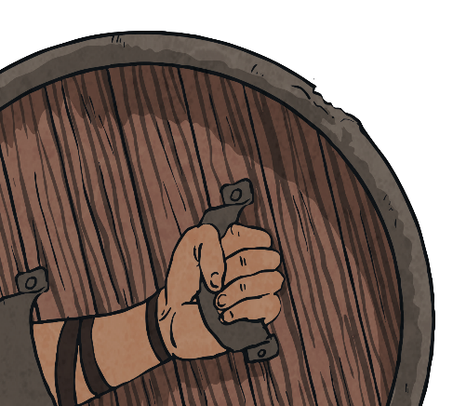
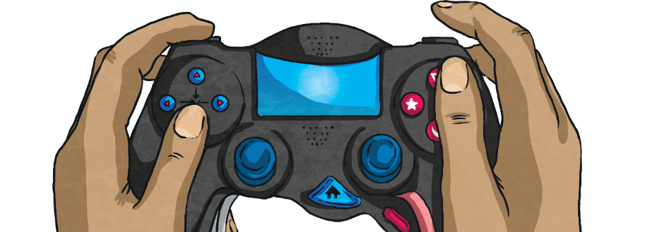
In the Media
The media is the main way of communicating to lots of people all at the same time - it might be through television, radio, magazines, books, newspapers and the Internet. So, ‘in the media’ means all the different information and messages we receive from these different places.
What does ‘in the media’ mean?
Talk to a partner and then share your thoughts with the class.

Slide 8
Exploring

Slide 9
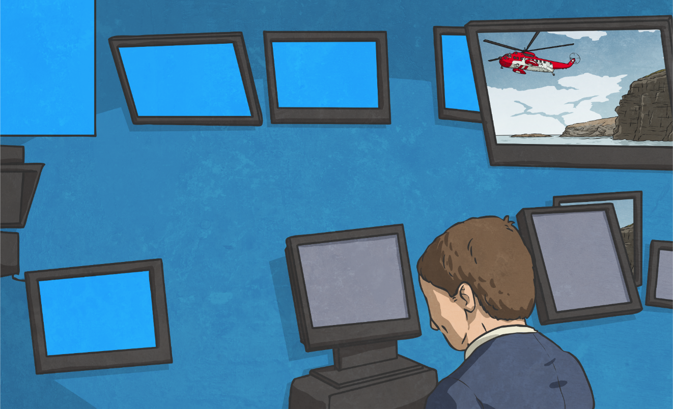
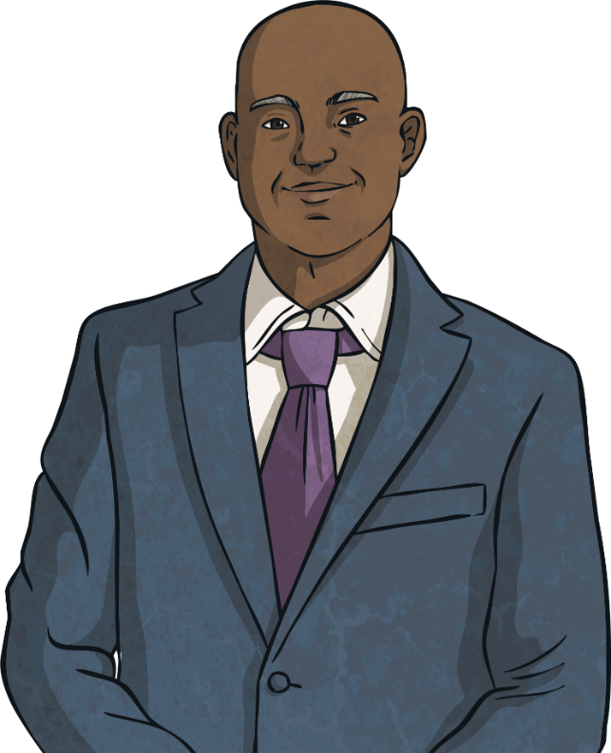
Media Messages
We get a huge amount of information from the media – both fact and opinion. The media also have the power to send certain messages about how we should look, feel and behave. This can be both helpful and harmful.
The media are very powerful. They can get information to a lot of people all at the same time.
Do we receive facts or opinions from the media?
What information do the media give us?

Slide 10
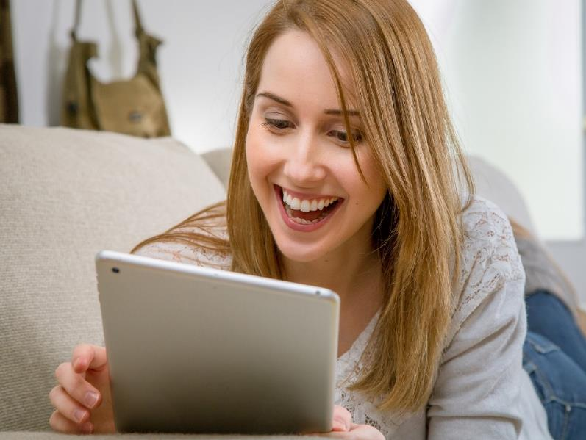
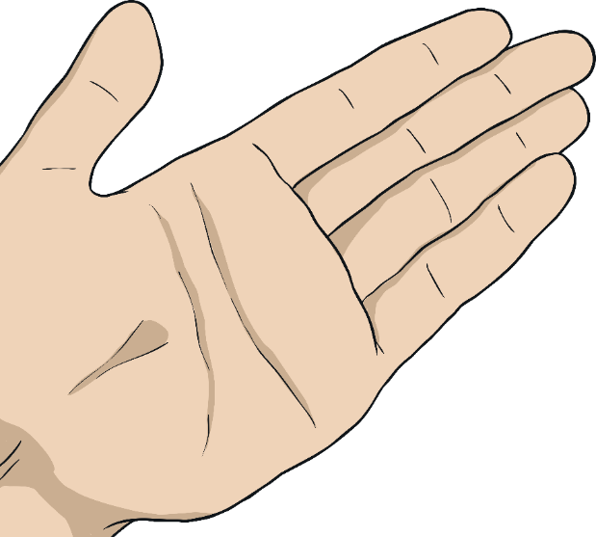
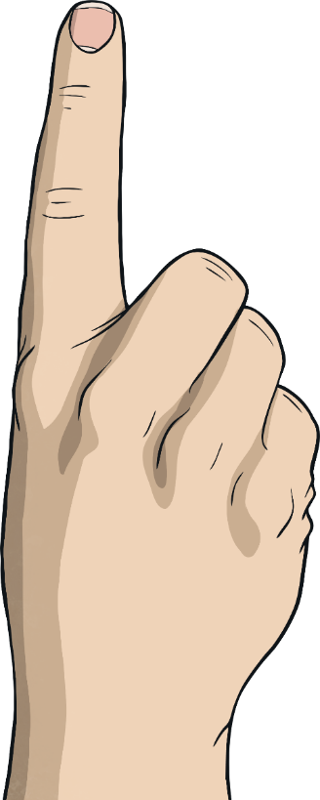
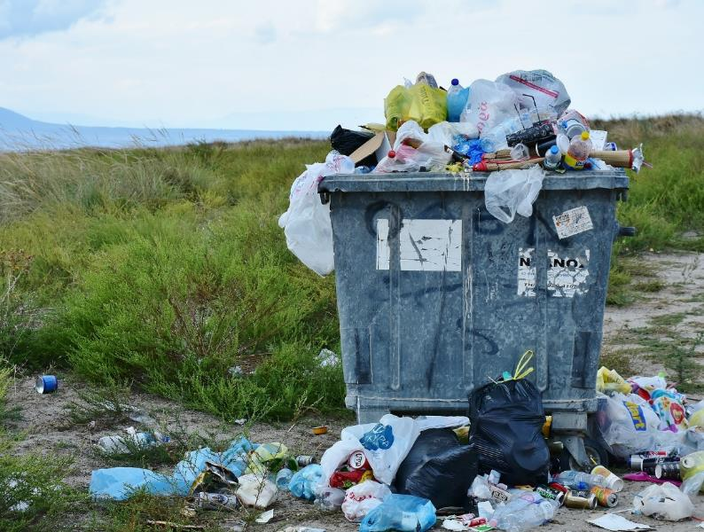
Helpful or Harmful?
In your groups, discuss what messages the following images from the media are giving us and decide if they are helpful or harmful.
Drowning in rubbish – the desperate need to reduce, reuse and recycle is ever increasing!
Fashion tips to make you feel happy and gain friends.
Buy the best of the latest tablets and be the envy of your friends!

Slide 11
Helpful or Harmful?
We must think very carefully about the messages we receive from the media:
The media have the power to make us think and feel certain things and behave in a certain way.
Do we feel comfortable with how they are making us feel?
Are they trying to sell us something?
Are they fact or opinion?
You are wonderfully unique and incredibly special. You don’t have to look, feel or behave a certain way to be worthy, happy or accepted. Just be yourself!
They can try and make us feel we have to buy certain things or look a certain way to feel happy and be successful.
Reflecting
Consolidating

Slide 12
Consolidating

Slide 13
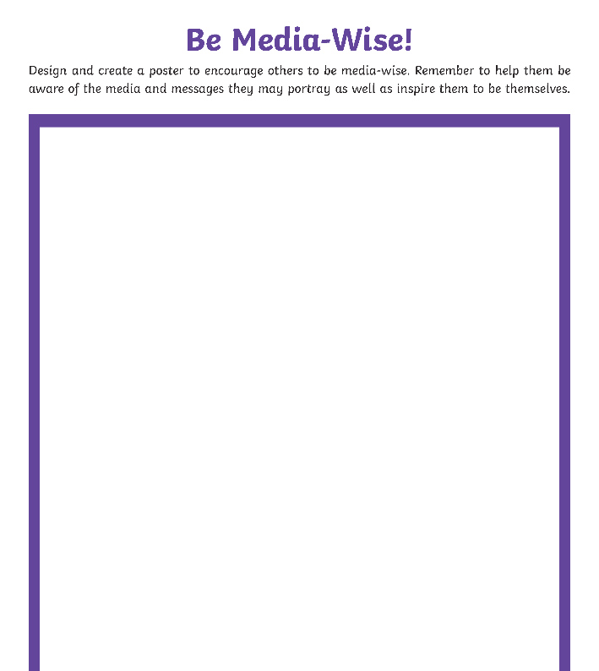
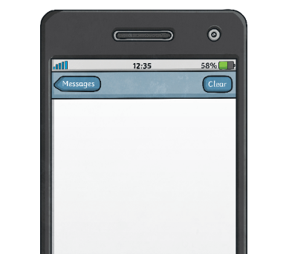
Be Media-Wise
Design and create a poster to encourage others to be media-wise. Remember to help them be aware of the media and messages they may portray as well as inspire them to be themselves.

Slide 14
Reflecting

Slide 15
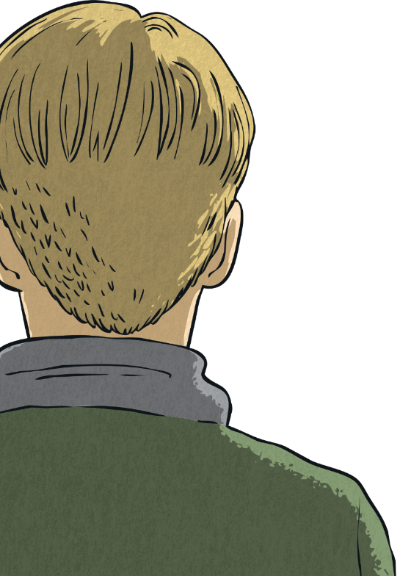
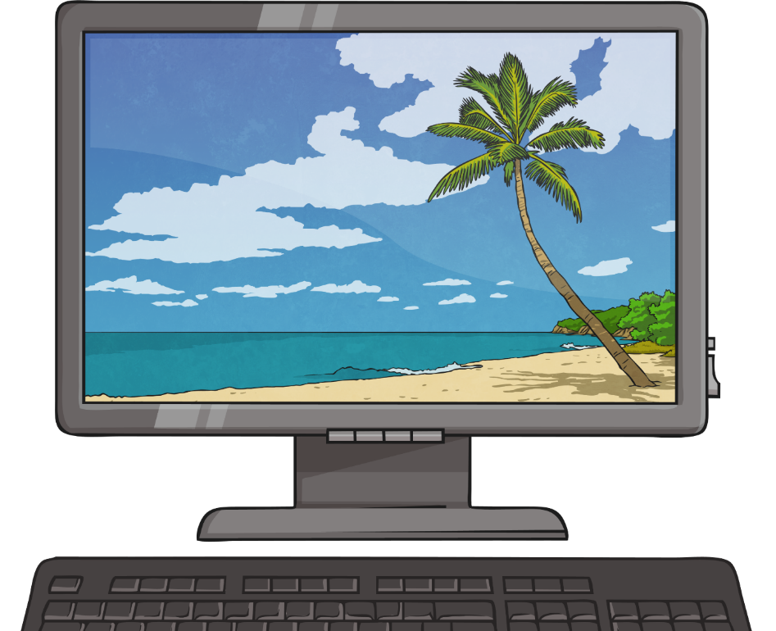
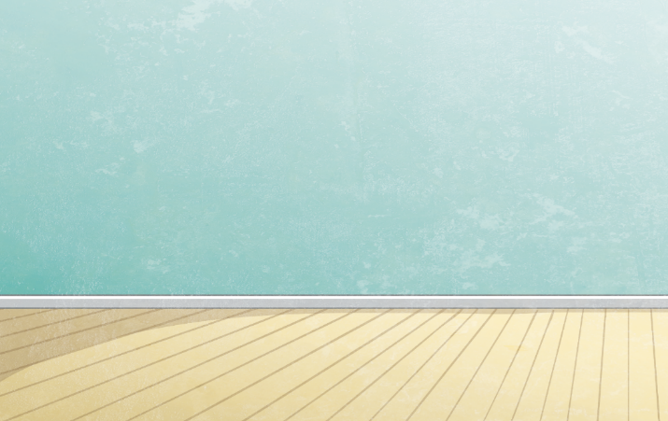
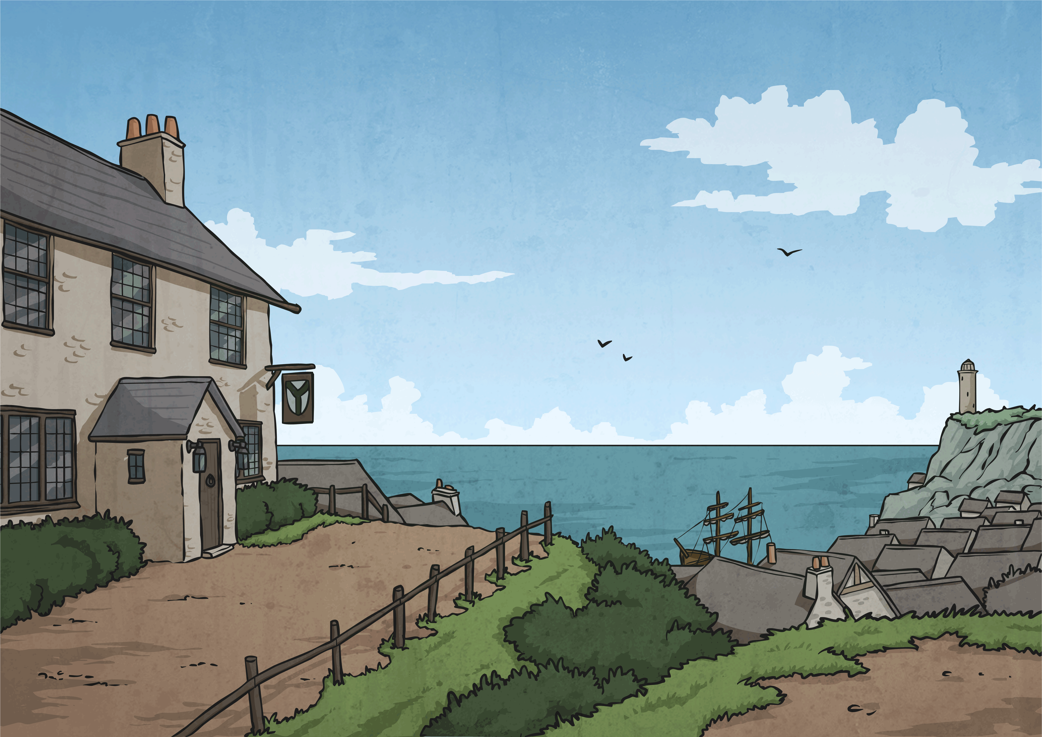
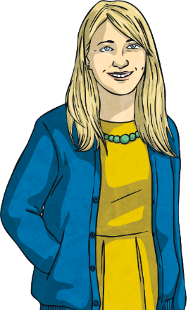
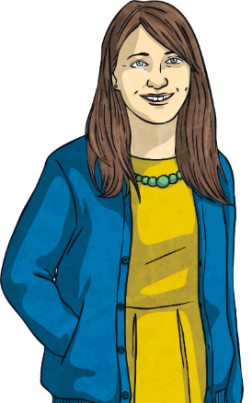
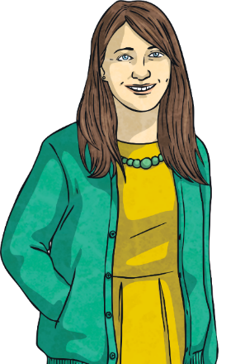
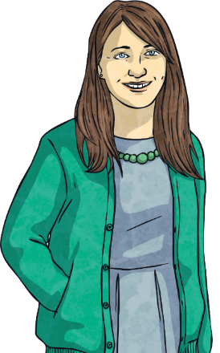
Reality
A lot of the images you see of people in the media have been edited and changed. Often this is done to create a ‘perfect’ look.
How do you think this ‘perfect’ look could make the reader or viewer feel?
How might it change how they want to look?
Do edited images show reality?
You are wonderfully unique and incredibly special. You don’t have to look, feel or behave a certain way to be worthy, happy or accepted. Just be yourself!
What could happen if people did not realise that the media change and edit a lot of the images they use?

Slide 16
The Big Questions

Slide 17
The Big Questions
What messages do we get from the media about how people should look, feel and behave?
Are those messages realistic?
How have your answers changed since the beginning of the lesson?

Slide 18
Aim
I can explore messages given by the media and decide if they are helpful or harmful.
Success Criteria
I can identify some of the ways that the media tries to influence the way we feel.
I can reflect on the reality of the messages given by the media.

