Slide 1
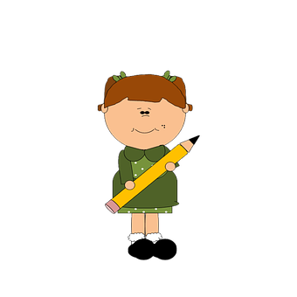
Parents: read our helpful guidance before you start
KS1 Home learning:
Making decisions
Play this slideshow from beginning
Remember! You can use your own paper to do the activities on, or type on the worksheets. You don’t have to print them off.

Slide 2
We are learning about making decisions
We will be able to:
recognise situations which involve a decision.
identify some decisions a person could make and who could help them.
describe how some decisions we make can be influenced by other people.

Slide 3
What’s our starting point?
Draw and write
Draw or write about a decision you have had to make about something, e.g. what to have for breakfast, what to wear today.
Draw or write about anything that influenced your decision.

Slide 4
We all have to make decisions
Here are some other decisions for you to make.
Look at the choices in Resource 1: Would you rather? (in your worksheet pack) and put a tick next to the decision you prefer.
Now write a reason for some of your decisions, e.g. because I prefer dogs, because it would be fun, because I don’t like the other option

Slide 5
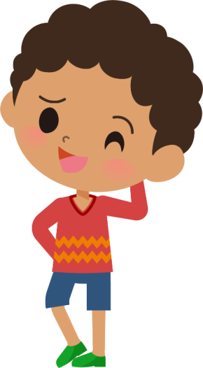
Draw or write all the people you can think of who can help us make decisions in each of the columns below (either using your own paper or Resource 2: Who can help? in your worksheet pack)
Who can help us make decisions?
If there was no-one was around to help you with your decision, what else might help?

Slide 6
Tricky decisions
Some choices are easy and others are more difficult.
Can you help Martin and Tasneem to make their decisions?
What are they each trying to decide between? Who or what could help them?
Draw or write your ideas on a piece of paper.
Martin’s mum has told him he needs to eat his carrots because they are good for him. But Martin really wants to eat the bag of sweets his granny left for him when she dropped off shopping to their house.
Tasneem has been given £10 for her birthday. She has to decide whether to spend it on buying a toy she wants, or saving it for the future. She is not sure which would be best.

Slide 7
What might happen next?
Thinking about the decisions that Martin and Tasneem have to make…
What do you think might happen next after they have made their decision?
Could anybody be affected, hurt or upset by their decision?
What else might affect their decision?
Share some of your ideas with a family member

Slide 8
Making decisions
Well done on completing the activities!
Now go back to the ‘What’s our starting point?’ activity
Draw and write
Is there anything you would like to change?
Is there anything you would like to add?

Slide 9
Remember
Everyone can find it difficult to make decisions sometimes. Adults can often find it difficult too.
It is okay to ask for help.
Go back to slide 5 to remind yourself of all the people you can ask for help

Slide 10
More activities
Create a poster giving three top tips for making decisions that you can share with someone at home, with family, or friends
Write a short story about a character who is struggling to make a decision. Include advice for others about who could help them with their decision making.

